Slide 1
Best Practices and Risk Management Options for Metal-Impacted Sites
Ryan Fimmen, PhD
Geosyntec Consultants, Inc.
Summer 2023

Slide 2
Disclaimer
This seminar is intended to be informational and does not indicate endorsement of a particular product(s) or technology by the Department of Defense or NAVFAC EXWC, nor should the presentation be construed as reflecting the official policy or position of any of those Agencies. Mention of specific product names, vendors, or source or information, trademarks, or manufacturers is for informational purposes only and does not constitute an endorsement or recommendation by the Department of Defense or NAVFAC EXWC. Although every attempt is made to provide reliable and accurate information, there is no warranty or representation as to the accuracy, adequacy, efficiency, or applicability of any product or technology discussed or mentioned during the seminar, including the suitability of any product or technology for a particular purpose.

Slide 3
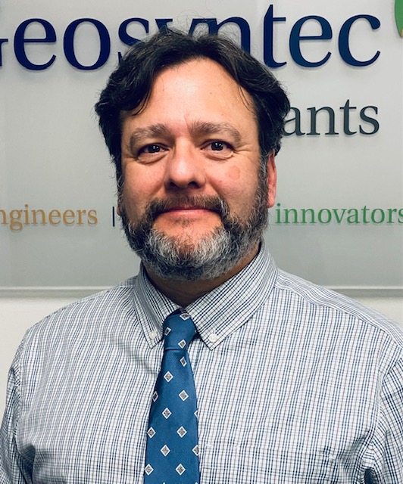
Speaker Introduction
Geosyntec Consultants
PhD, Geochemistry; MS, Chemistry; BA, Chemistry
Over 15 years experience
  Remediation of soil, sediment, and groundwater, including MNA
  Contaminant fate and transport
  Forensic analysis and isotopic fingerprinting of
  metal-impacted sites
  Research and development of environmental remedial technologies
  Litigation support
Ryan Fimmen, PhD
MNA: monitored natural attenuation

Slide 4
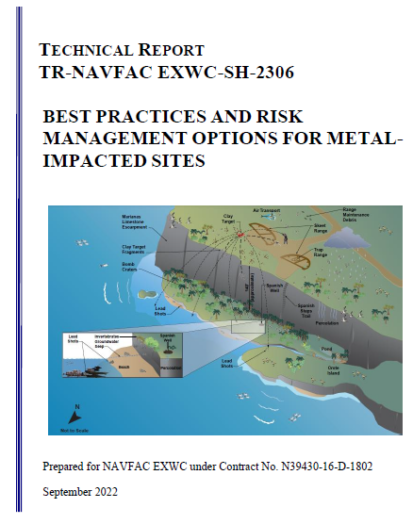
Presentation Overview
Overview
Key chemistry
CSM development
Environmental site assessment for metals-impacted sites
Technical challenges at NAVFAC sites
Summary and closing statements
Today’s presentation is adapted from the recent NAFVAC EXWC Technical Report Best Practices and Risk Management Options for Metal-Impacted Sites (NAFVAC 2022)
CSM: conceptual site model
Notes:
On this slide, I will elaborate the different topics that will be discussed in today’s presentation.

Slide 5


Interactive Polling!
Today’s presentation will feature three interactive poll questions.
Overview
Notes:
Here are instructions for how to engage with the interactive polling.

Slide 6
Past Related RITS Topics
2017
2020
2021
2022
2022
Passive Groundwater Sampling: Effective Tools to Transition Your Program
Innovations in In Situ Sediment Remediation
Phytoremediation: State of the Practice and New Advances
Applying ISM at Navy Sites
Practical Methods to Implement MNA at ER Sites
How to Use Soil Background during Risk Assessments
2016
ER: environmental restoration
ISM: incremental sampling methodology
MNA: monitored natural attenuation
Overview
Notes:
Some passive groundwater samples can capture metals concentrations. In situ sediment remediation includes metals stabilization. Phytoremediation goes into the mechanisms of metals remediation. ISM is something we’ll mention in a case study later on.

Slide 7

Key Points
Environmental chemistry influences fate and transport and effects on human and ecological receptors
Metals are naturally occurring and vary in form, toxicity, and background concentration
A CSM should reflect site chemistry and help design the remedy
Common NAVFAC site issues with metal impacts are SAFRs and lead and arsenic in groundwater
KEY POINT
Metals are neither degraded nor destroyed.
SAFR: small arms firing range
Overview
Notes:
The common theme is that metals are not degraded or destroyed in the same way organics are.

Slide 8
Metals Overview
Metals are naturally occurring and exist in varied concentrations and mixtures
Metals/metalloids are elements that generally form positive ions by losing electrons during chemical reactions
  Number of electrons lost or gained defined as “oxidation state”
Environmental conditions affect solubility, mobility, availability, and toxicity
Metals of primary interest at cleanup sites (US EPA 2007)
Aluminum (Al) | Cadmium* (Cd) | Manganese (Mn) | Strontium (Sr)
Antimony (Sb) | Chromium* (Cr) | Mercury (inorganic)* (Hg) | Tin (Sn)
Arsenic* (As) | Cobalt (Co) | Molybdenum (Mo) | Thallium (Tl)
Barium* (Ba) | Copper (Cu) | Nickel (Ni) | Vanadium (V)
Beryllium (Be) | Iron (Fe) | Selenium* (Se) | Zinc (Zn)
Boron (B) | Lead* (Pb) | Silver* (Ag)
*RCRA 8 Metals, regulated as hazardous waste
RCRA: Resource Conservation and Recovery Act US EPA: United States Environmental Protection Agency
Overview
Notes:
Introduce chemistry for details later on.

Slide 9
Metals Occurrence at NAVFAC ERP Sites
20% of NAVFAC Southeast
Common sources at NAVFAC ERP sites
  Industrial processes
  SAFRs
  Waste disposal
  Pesticide and herbicide application
Frequently co-contaminants
Contaminants at NAVFAC southeast restoration sites in 2020
(NAVFAC 2022)
ERP: Environmental Restoration Program
Overview
Notes:
This might not be representative of all NAVFAC sites, but it is intended to be an example of how common metals impacts are across NAVFAC sites.

Slide 10
Poll Question 1
Do you have metal impacts at a site you manage, regulate, or consult on?
Options to respond:
1. Text ‘ritsn200’ to 22333 to join session
then enter response
2. Enter PollEv.com/ritsn200 in browser
3. Scan the QR code and open session in browser
Overview
Notes:
Please use the polling app to respond.

Slide 11
Presentation Overview
Overview
Key chemistry
CSM development
Environmental site assessment for metals-impacted sites
Technical challenges at NAVFAC sites
Summary and closing statements

Slide 12
Key Chemistry
1
2
3
Reduction + Oxidation (Redox)
Attenuation + Transport
Bioavailability + Bioaccumulation
You remember electrons from high school, right?
How it spreads
and how it
s p r e a d s
Who’s eating it?
Are you eating them?
Key Chemistry
Notes:
We will cover basic chemistry concepts needed to understand how to develop CSMs and remedial strategies for metals.

Slide 13


Redox Chemistry
Electrochemistry is about transfer of electrons
  OIL RIG: oxidation is loss―reduction is gain
  LEO GER: loss of electrons is oxidation―gain of electrons is reduction
Oxidation state is the number of electrons lost or gained
  Fe(0): elemental iron/ZVI
  Fe(II) or Fe²⁺: ferrous iron (missing two electrons, oxidized)
    Reduced compared to ferric
    Tends to lose electrons to become ferric iron in the environment
    Sometimes the term “ferrous” just means containing iron
  Fe(III) or Fe³⁺: ferric iron (missing three electrons, oxidized)
Two half reactions put together make a full reaction
GER
ZVI: zerovalent iron
(Images from Microsoft PowerPoint 2023)
Key Chemistry
Notes:
ZVI is frequently used in groundwater treatment as a reductant because it gives up electrons. Non-chemistry definition of ferrous is for ferrous metals containing iron. That definition has nothing to do with the oxidation state of the metal. For example, steel is called a ferrous metal because it contains iron.

Slide 14
Redox Effects
Redox reactions change the oxidation state
  Example: corrosion of lead: Pb(0) to Pb(II)
    2Pb(s) + O₂(g) + 2H₂O(aq) → 2Pb(OH) ₂
      Pb(s) → Pb(II) + 2e⁻
      O₂(g) + 2H₂O + 4e⁻ → 4OH⁻
Oxidation state affects form and toxicity of a metal
  Cr(III) vs Cr(VI)
    Trivalent chromium―low toxicity, trace mineral essential to human nutrition
    Hexavalent chromium―high toxicity, Group 1 carcinogen
Understand which remedial methods affect desired chemistry…
…and what can make it worse
KEY POINT
Primary goal of metal remediation
is to make it a less toxic form.
Key Chemistry
Notes:
Half reactions are useful to understand stoichiometry of redox reactions. The redox state of metals can vary depending on factors such as pH and ORP, and the different oxidation states of a single element can have vastly different environmental reactivity and toxicity.

Slide 15
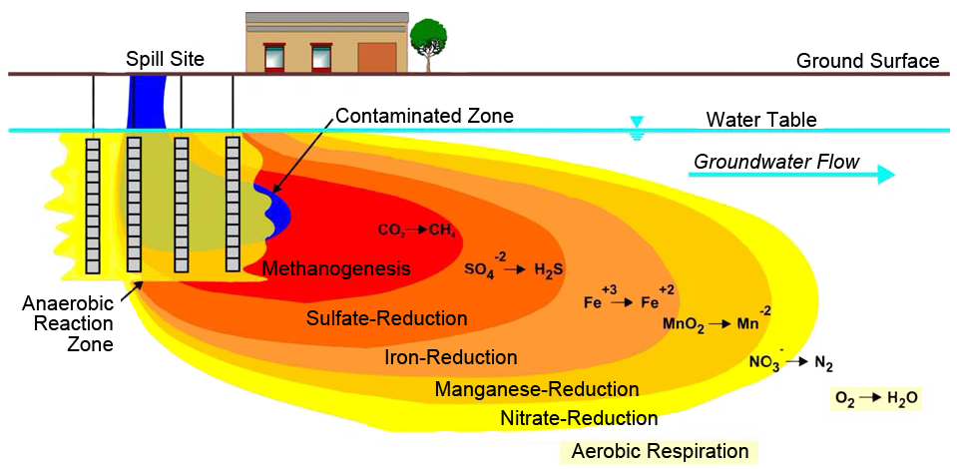
Redox Gradients
Anaerobic microbes use electron acceptors in preferential order
(Parsons 2004)
Key Chemistry
Notes:
Consideration of redox gradients is for now and in the future. Changing conditions in the subsurface existing naturally or within a spill will affect your metals. This is especially important for co-contamination sites. This concept is highlighted in Case Study #4 where reducing conditions attributed to a combination of natural conditions and hydrocarbon releases affect arsenic mobilization.

Slide 16
Why Is It Called Oxidation?
Oxidants are substances that steal electrons from/oxidize other substances
Most common oxidants are composed of/contain oxygen
  O₂, O₃, H₂O₂, NO₂, HNO₃, Na₂S₂O₈, N₂O, KMnO₄
Be careful when sampling redox-sensitive species
  Aerobic versus anaerobic conditions
  Example: arsenic sampling from anaerobic groundwater
    As(III) more toxic and mobile than As(V)
    If you’re sampling for arsenite (AsO₃³⁻), but you expose your sample to oxygen, you’ll convert it to arsenate (AsO₄³⁻) and be wrong
Key Chemistry
Notes:
Historically, oxidation used to mean “to add oxygen to something.” Now that we understand electron transfer processes, it is understood that when we add oxygen to something, we are causing an electrochemical reaction. So, the oxidation process involves electron transfers even though not every oxidation reaction uses oxygen as the oxidant. Nitrate is another common environmental oxidant. The effect of oxidation during environmental assessment given here is for arsenic groundwater sampling in reducing conditions with high dissolved iron. If air is introduced in the samples (i.e., oxygen gets into your groundwater sample vials), you now have a reddish powder (iron oxidation and precipitation), arsenic will adsorb to the iron precipitation, and the groundwater samples will artificially be nondetect for dissolved arsenic.
NOTE: say the words for the oxidants

Slide 17
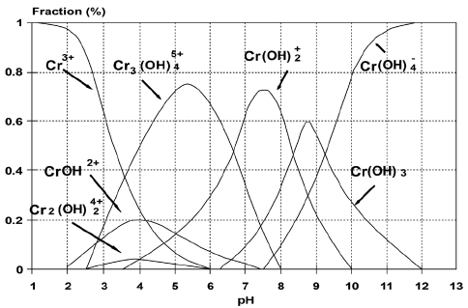
Redox and Speciation
Speciation refers to multiple physical and chemical forms
  Solid or dissolved
  Element, mineral, cation in water, or bound to inorganic or organic molecules
Speciation depends on metal properties and environmental conditions
  pH, redox potential, concentrations of molecules that can form complexes
  ORP is a field measurement of Eh, used in speciation diagrams
Chromium (III) speciation diagram
(Santos 2011)
ORP: oxidation reduction potential
Eh: standard reduction potential
Key Chemistry
Notes:
This graph is sometimes called a predominance area diagram. The trend lines show the relative abundance of each dissolved chromium aqueous species as a function of pH. In the next slide, we will see how the speciation also changes with ORP and how to combine the pH and ORP effects on one predominance area diagram. ORP is a field measurement of Eh. ORP uses a reference electrode (usually Ag/AgCl). To convert to Eh, you adjust your ORP measurement by the standard potential of the reference (~200 mV for Ag/AgCl).

Slide 18
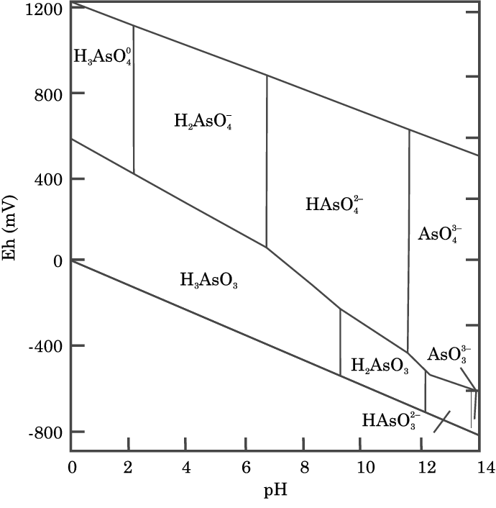
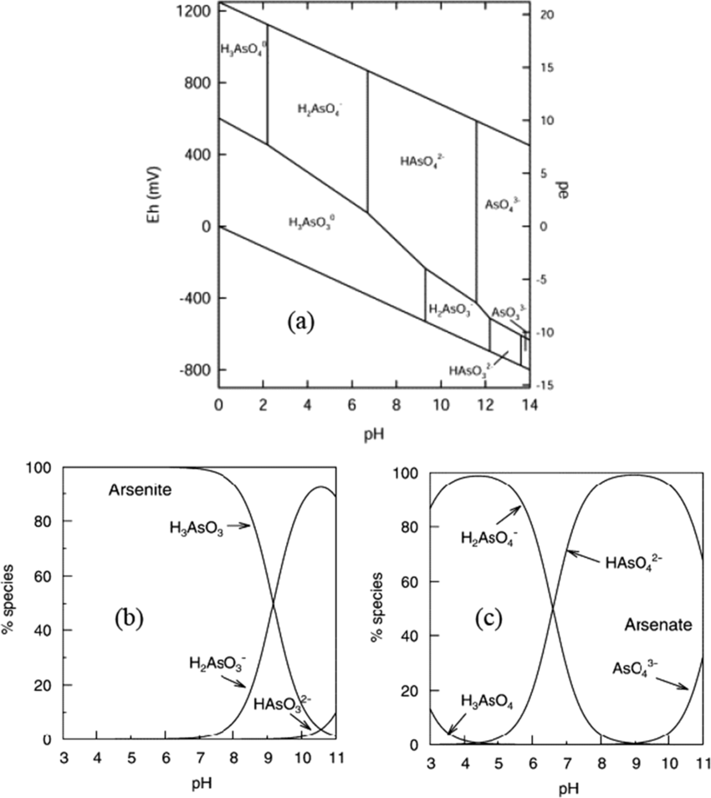
Arsenic Speciation
Eh-pH/predominance diagram of arsenic species in water (25°C)
Species of As(III) as a function of pH
Species of As(V) as a function of pH
-
°C: degrees Celsius
(Syafiuddin 2020)
Key Chemistry
Notes:
The first two plots show how the predominance of dissolved species change as a function of pH. In this example, the transition points correspond to the pKa values for each metal. The figure on the right shows the effect of redox and, in this case, continues to show the different dissolved species of arsenic. In other instances, it is not uncommon for the Eh-pH diagram to also show solid phases.

Slide 19
Case Study 1: Excavation and In Situ Treatment of Hexavalent Chromium in Groundwater
Naval Support Facility Dahlgren
Dahlgren, Virginia
NAVFAC Washington 2009
NAVFAC Washington 2019
NAVFAC Washington 2022

Slide 20
Site Overview
Background
Site 14, a former chemical waste evaporation pond, 120 feet x 60 feet
Historical discharges of waste chemicals
Chemical warfare waste
Gun barrel rinsing
Primary contaminant of concern and media
Total chromium (Cr) and hexavalent chromium (Cr(VI))
Soil and groundwater
Selected remedial action
Source removal (excavate 7 feet of soil)
In situ chemical reduction of groundwater
CPS
Redox reaction to convert Cr(VI) to Cr(III)
CPS: calcium polysulfide solution
Key Chemistry: Case Study 1
Notes:
The evaporation pond was constructed in 1967 for the disposal of alcohol-based caustic solutions used for decontaminating chemical waste. In 2008, a removal action was performed to remove contaminated soil down to a depth of 11 feet below ground surface, which was approximately 2 feet below the groundwater table. A soil amendment (calcium polysulfide) was then applied to the base of the excavation to address hexavalent chromium in groundwater, and the excavation was backfilled with clean fill from an off-site source.

Slide 21
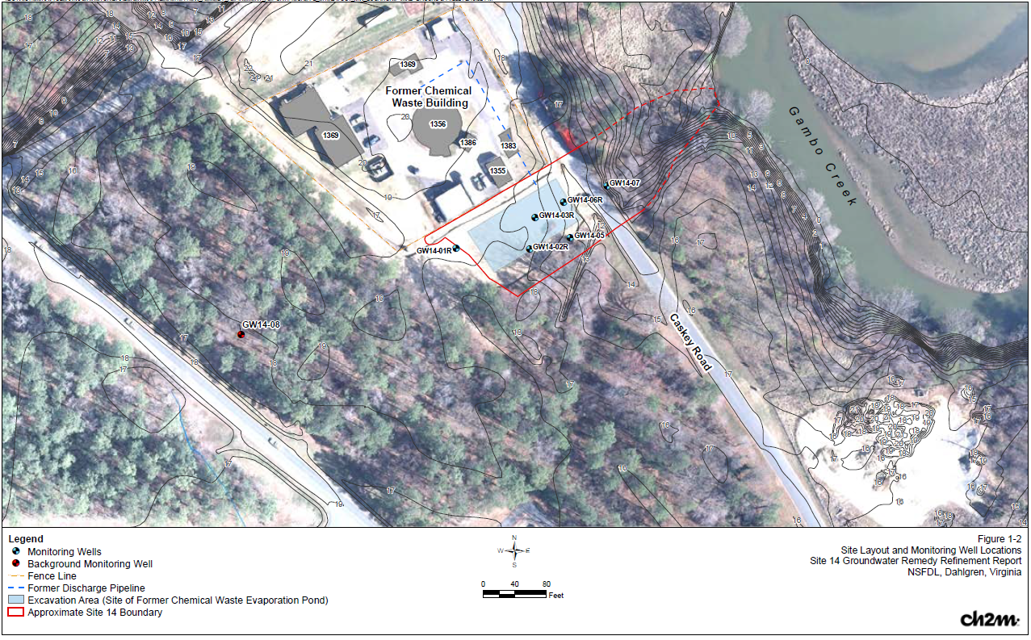
Site Overview
(NAVFAC Washington 2022)
Key Chemistry: Case Study 1
Notes:
The black outline is the footprint of the former evaporating pond. Groundwater flows to the northeast, eventually discharging to the creek.

Slide 22
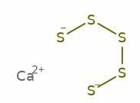
Calcium Polysulfide
Also known as lime sulfur
Establishes a reducing environment in groundwater
Precipitates nontoxic
metal sulfides (As, Pb, Cd, and Cu)
Is cost effective
Supports growth of sulfate-reducing bacteria, which occur naturally in aquifers but thrive under anaerobic, reducing conditions
  SRBs convert sulfate produced by CPS back into sulfide ions
  SRBs limit net production of sulfates
Calcium Polysulfide Structure
(ChemSpider 2023)
Key Chemistry: Case Study 1
Notes:
Calcium polysulfide is a reducing agent that is relatively long-lasting. This reagent will create reducing conditions that will affect the conversion of the more-soluble hexavalent chromium to the less-soluble trichrome.

Slide 23
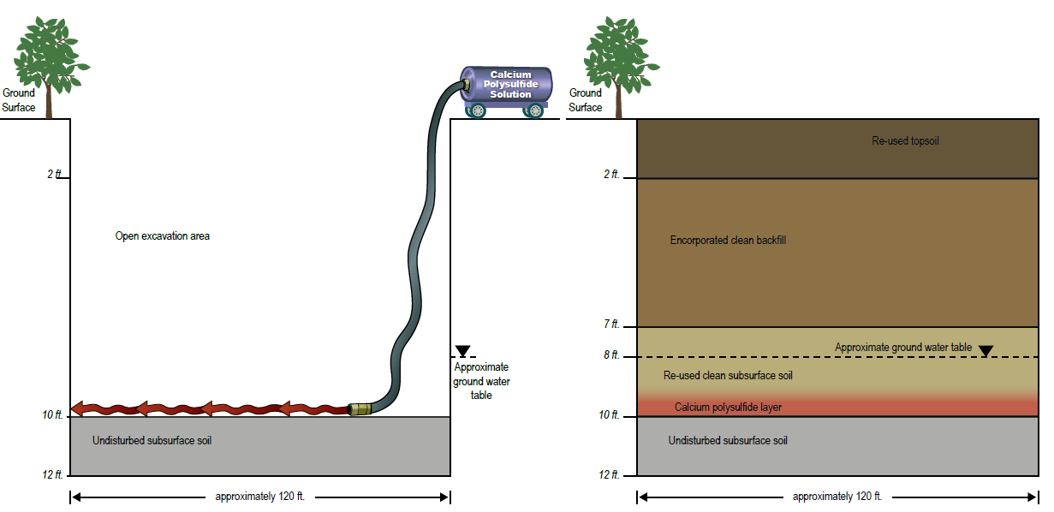
CPS Application and Soil Backfilling
(NAVFAC 2022)
Key Chemistry: Case Study 1
Notes:
The figure here shows excavation/backfill of the evaporation pond in cross-sectional view. Source removal, including soil excavation and off-site removal, was combined with in situ chemical reduction treatment of groundwater using calcium polysulfide (CPS). The CPS treatment facilitates a redox change and a series of reactions that convert Cr(VI) to trivalent chromium (Cr(III)). The remedy was selected to mitigate the potential transport of Cr(VI) from subsurface soil into the groundwater and to reduce concentrations of Cr(VI) in groundwater. As shown in Figure C1-1, soil was excavated and removed to a depth of 7 feet based on remedial action objectives for Cr in soil. Further excavation from 7 to 10 feet was conducted so that CPS could be applied at the water table. After CPS application, the additional excavation material was placed back in the excavated area before backfilling with clean soil (NAVFAC Washington 2006).

Slide 24
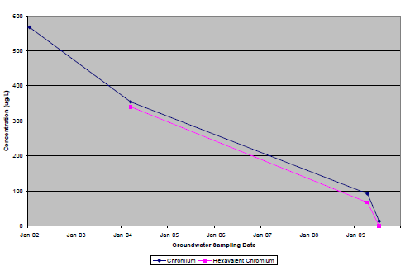
Chromium Removal
Soil
  Preexcavation 1.8–330 mg/kg Cr(VI)
Groundwater
  Initial > 300 µg/L Cr(VI)
Post-remedy Soil and Groundwater
  Trace Cr(VI) in groundwater
  Some anomalous readings
Monitoring continued after initial remedy for further remedial action if needed
Chromium concentrations over time: unfiltered groundwater
600
500
400
300
200
100
0
Total Chromium
Hexavalent Chromium
Concentrations (µg/L)
Jan-02 Jan-03 Jan-04 Jan-05 Jan-06 Jan-7 Jan-08 Jan-09 Jan-10
Groundwater Sampling Date
(NAVFAC Washington 2009)
µg/L: microgram(s) per liter
mg/kg: milligram(s) per kilogram
Key Chemistry: Case Study 1
Notes:
The in situ chemical reduction was very effective at reducing dissolved chromium concentrations to below remedial targets. However, downgradient impacts may yet be impacting Gambo Creek.

Slide 25
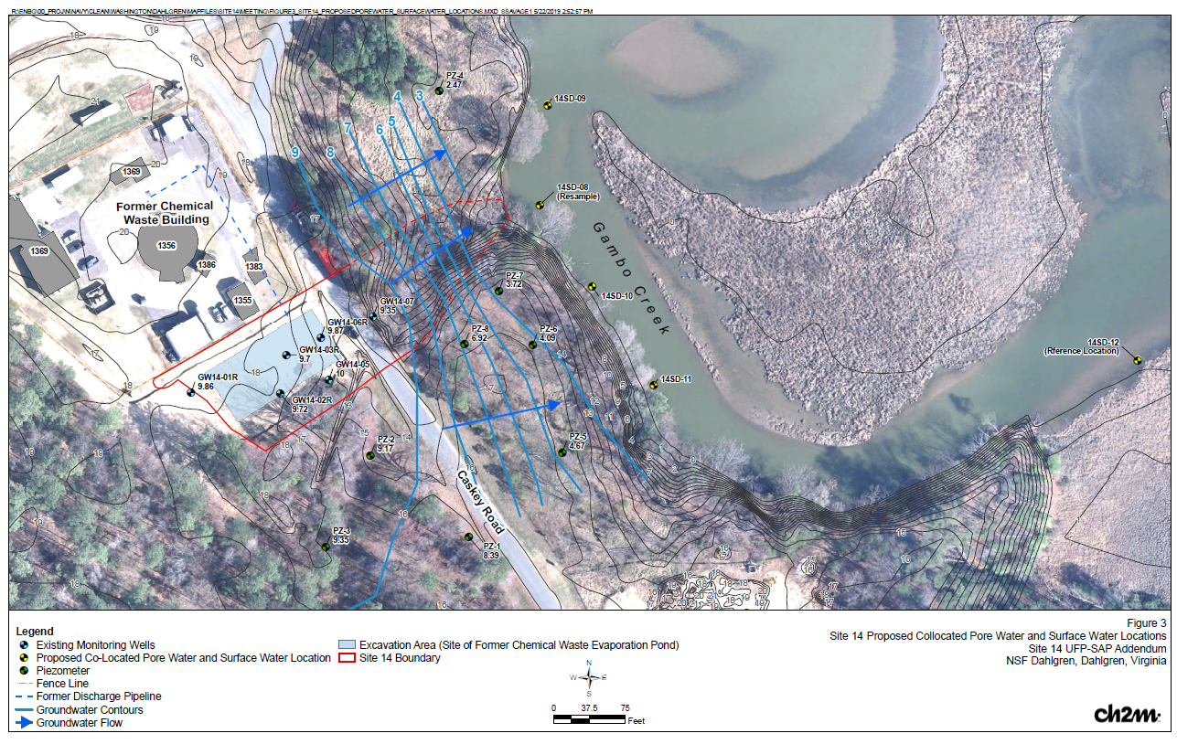
Further Study Post-Remedy
Conduct human health risk assessment
  Arsenic, chromium, cobalt, cyanide manganese, and iron remained above screening levels
Investigate surface water and sediment porewater for potential transport
(NAVFAC Washington 2022)
Key Chemistry: Case Study 1
Notes:
This is a later study, investigating the human and ecological risk factors and expanding further into arsenic, chromium, iron, and manganese, as well as pore and surface water, as the remedy continues to evolve. The main message to understand is that while the work is still ongoing to understand downgradient impacts, the in situ reduction of hexavalent chromium to insoluble trivalent chromium was successful for treating the source area.

Slide 26
Summary
Best Practices
Lessons Learned
  Pre-EE/CA investigation helped to
  delineate horizontal and vertical bounds or excavation
  Remedy removed source and reduced concentration of contaminant
  Quarterly groundwater
  monitoring implemented for 2 years post-remedy to track concentrations
  Groundwater remediation was complex
    Significant removal of Cr
    Cr and other metals remained above MCLs and required additional investigation
    and remedy
  CSM may change through time
    Cr remedy executed in 2008
    Remedy refinement investigation conducted in 2016 for adjacent water body
    Additional transport pathways characterized in 2020
EE/CA: engineering evaluation/cost analysis
MCL: maximum contaminant level
Key Chemistry: Case Study 1
Notes:
CSM is a preview of what’s to come later in the slides. While the source area was being excavated and treated, additional downgradient investigation into groundwater and porewater impacts helped to refine/revise the CSM.

Slide 27
Key Chemistry
1
2
3
Reduction + Oxidation (Redox)
Attenuation + Transport
Bioavailability + Bioaccumulation
You remember electrons from high school, right?
How it spreads
and how it
s p r e a d s
Who’s eating it?
Are you eating them?
Key Chemistry

Slide 28
Attenuation and Transport
Attenuation
Processes that reduce mass, toxicity, mobility, volume,
or concentration
Precipitation-coprecipitation-dissolution
Sorption-desorption
Biological stabilization
Dilution-dispersion
Transport
Processes of movement
Advection: going with the flow
Diffusion: molecular movement from high to low concentration
Dispersion: turbulent mixing in all directions
Examples
Examples
Key Chemistry
Notes:
This slide is intended to define attenuation and transport and provide examples of each.

Slide 29
Solubility and Precipitation
Solubility is based on equilibrium
Solubility is the extent to which a constituent will dissolve in water
  Highly dependent on oxidation state
  Tends to decrease with increased pH
Some metal salts are essentially insoluble once precipitated or sorb to soil once precipitated
KEY POINT
Precipitation of metals from groundwater is a stabilization/remedial strategy.
Key Chemistry
Notes:
Point out that solubility of any solid is defined by equilibrium constants, which are a thermodynamic property. Equilibrium solubilities depend on other factors, such as temperature, pH, and redox potential.

Slide 30
Adsorption and Ion Exchange
Process of metal sticking to new material by partial electrochemical attraction or exchange
  Follows an equilibrium, with maximum reached
Processes occur within soil, sediment, and water (sometimes)
  Clay minerals (can retain significant quantities of metals)
  Hydroxides/carbonates
  Organic matter (in soil or water)
Pb²⁺
Mg²⁺
Ca²⁺
Pb²⁺
Pb²⁺
O²⁻
Carbon
O²⁻
Si⁴⁺
O²⁻
O²⁻
Sorption
Lead on GAC
Ion exchange
Metals with clay silicate layers
GAC: granular activated carbon
Key Chemistry
Notes:
Several naturally occurring materials can act as effective geosorbents. Clay minerals, especially high-activity 2:1 minerals have higher cation exchange capacity. Clay minerals have structural charge imbalances, which result in permanent cation exchange capacity. Oxides of iron, aluminum, and manganese are also common ion exchange materials. In contrast to clay minerals, oxides are variable charge minerals with ion exchange properties dependent upon pH, with higher cation exchange capacity at higher pH range. Organic matter can be extremely effective but is not typically abundant in groundwater aquifers; it is more common in surficial soils and sediments.

Slide 31
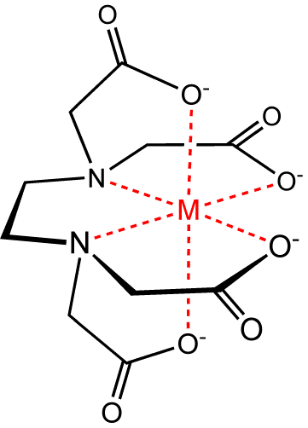
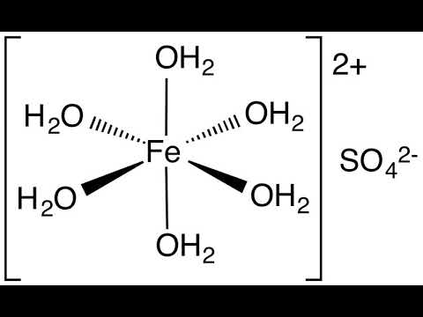
Complexation
Complex: composed of two or more substances
Partial bond formed between metal and ligand, where ligand donates electrons
Frequent anions that form complexes
  Hydroxyl (OH⁻)
  Carbonate (CO₃²⁻)
  Phosphate (PO₄³⁻)
  Sulfate (SO₄²⁻)
  Chloride (Cl⁻)
Fe
Iron EDTA Complex
(Buryan 2016)
Iron(II) Sulfate in Water
(ChemSpider 2023)
Key Chemistry
Notes:
When we talk about “free” metals, they are usually considered to be in an aqueous complex, which is depicted here, in an octahedral arrangement (six waters per metal). However, depending on the metal and the pH, the waters can lose protons to become hydroxyl groups (OH -) or even oxo groups (O -2). And with more complex water ion chemistry, several common anions can form complexes with positively charged metals. In more complex situations, especially with organic molecules, each molecule can have multiple binding sites such that each molecule can occupy more than one binding site (multi-dentate). Shown here is an iron-EDTA complex, where EDTA is considered a chelating agent such that a single EDTA molecule can wrap around the metal ion and occupy all six binding sites.

Slide 32
Metals and Attenuation Type
Inorganic and Attenuation Type | Attenuation Pathway | Parameters to Monitor
Conservative constituents B, Cl, Li, Na, K | Physical attenuation | Concentration distribution or mass flux
Sorption (anions) Sb, As, Cr(VI), F, Mo, Se, V(V) | Sorption increases as pH decreases | pH, ORP, anion exchange capacity, ionic strength
Sorption (cations) Ba, Be, Cd, Ca, Cr(III), Co, Cu, Fe, Pb, Mn, Hg, Ra, Tl, V(III), V(IV), Zn | Sorption increases as pH increases | pH, ORP, cation exchange capacity, ionic strength
Sorption to organic matter Cr(III), Cr(VI), Co, Cu, Pb, Hg, Ni, V(IV), Zn | Complexes with DOC may increase transport | DOC, total organic matter, constituent concentration from filtered and unfiltered samples
(ITRC 2015)
DOC: dissolved organic carbon
Key Chemistry
Notes:
I am not going through the full table. It is more of a useful reference to hold on to, but I will point out some key metals, such as lead and chromium.

Slide 33
Metals and Attenuation Type: Precipitation
Inorganic and Attenuation Type | Attenuation Pathway | Parameters to Monitor
Precipitation as or with oxides, sorption to oxides Sb, As, Cd, Cr(III), Co, Cu, Fe, Pb, Mn, Hg, Mo, Ni, Ra, Se, Tl, V, Zn | Favored in oxic conditions Mineralogy influences sorption capacity Decrease in pH/shift from oxic to reducing may remobilize | pH, ORP, DO, solid-phase mineralogy, concentration of precipitant, DOC, total and dissolved iron and manganese
Precipitation as or with sulfides, sorption to sulfides Sb, As, Cd, Cr(III), Co, Cu, Fe, Pb, Hg, Mo, Ni, Se, Zn | Favored in reducing conditions when sulfide present Increase in pH/shift from reducing to oxic may remobilize | pH, ORP, DO, solid-phase mineralogy, dissolved sulfide and sulfate concentration, DOC
Precipitation as or with sulfates Ba, Pb, Ra | Shift from oxic to reducing destabilizes sulfates | pH, ORP, DO, sulfate concentration
Precipitation as or with carbonates Ba, Cd, Ca, Co, Cu, Fe, Pb, Mn, Ni, Ra, Zn | Precipitation favored pH 8–11 Decreased pH and decreased alkalinity dissolve carbonates | Alkalinity, pH
(ITRC 2015)
DO: dissolved oxygen
Key Chemistry
Notes:
Carbonates are not redox sensitive but are very sensitive to decreasing pH.

Slide 34

Chemical Reactions and Forms
Dissolved Inorganic Complexes
Dissolved Organic Complexes
Dissolved
Free Metal
Solid
Precipitates and
Co-precipitates
Adsorbates
(Bourg 1995)
Key Chemistry
Notes:
Use the previous concepts to discuss how this figure brings the other topics together. Free metals are typically more mobile and more bioavailable. Dissolved forms are on the top, and attenuated forms are below.

Slide 35
Key Chemistry
1
2
3
Reduction + Oxidation (Redox)
Attenuation + Transport
Bioavailability + Bioaccumulation
You remember electrons from high school, right?
How it spreads
and how it
s p r e a d s
Who’s eating it?
Are you eating them?
Key Chemistry

Slide 36
Bioavailability
Extent to which a substance can be taken in by a living organism
Viewed as three processes
  Chemical availability
    Fraction of total concentration that contributes
    to exposure
    Some portion may be bound to organic matter and not available
  Uptake by organisms
    Ingestion
    Inhalation
    Skin contact
  Internal distribution of the substance
Key Chemistry
Notes:
Bioavailability can be significantly different across different oxidation states. Mercury is a classic example where zero valent mercury is largely unavailable in aquatic ecosystems, but organic (methylmercury) is highly bioavailable. The exposure route also makes a very large difference in terms of bioavailability considerations. Finally, toxicity can also be quite different across oxidation states, such as for arsenic.

Slide 37
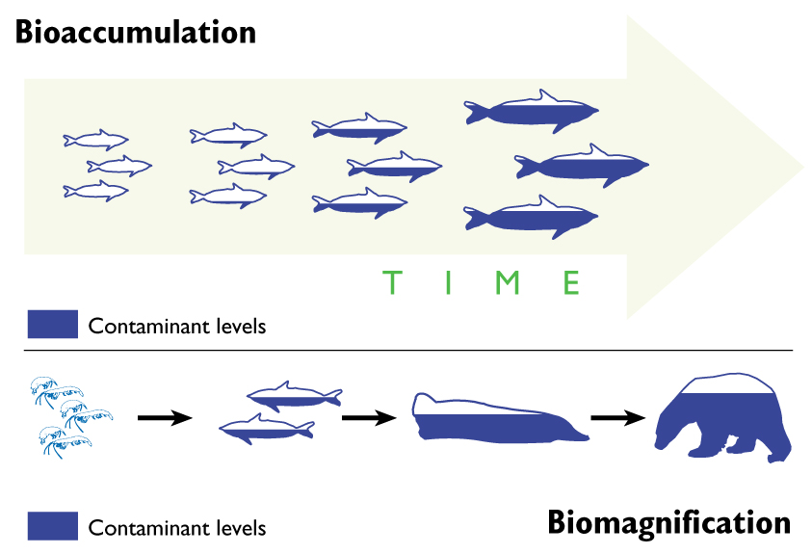
Bioaccumulation
Net accumulation of all routes of exposure
Accumulates faster than an organism can metabolize or expel it
Concentrates up food chain, biomagnification (e.g., methylmercury in aquatic life)
(van der Hoop 2013)
Key Chemistry
Notes:
This slide builds from the prior slide where bioavailability differences of different oxidation states was discussed. Bioaccumulation, as it relates to risk management for metals-impacted sites, is most likely to be relevant to sediment sites―not so much for groundwater, except where groundwater contributing to surface water/sediments impacts is part of the CSM.

Slide 38
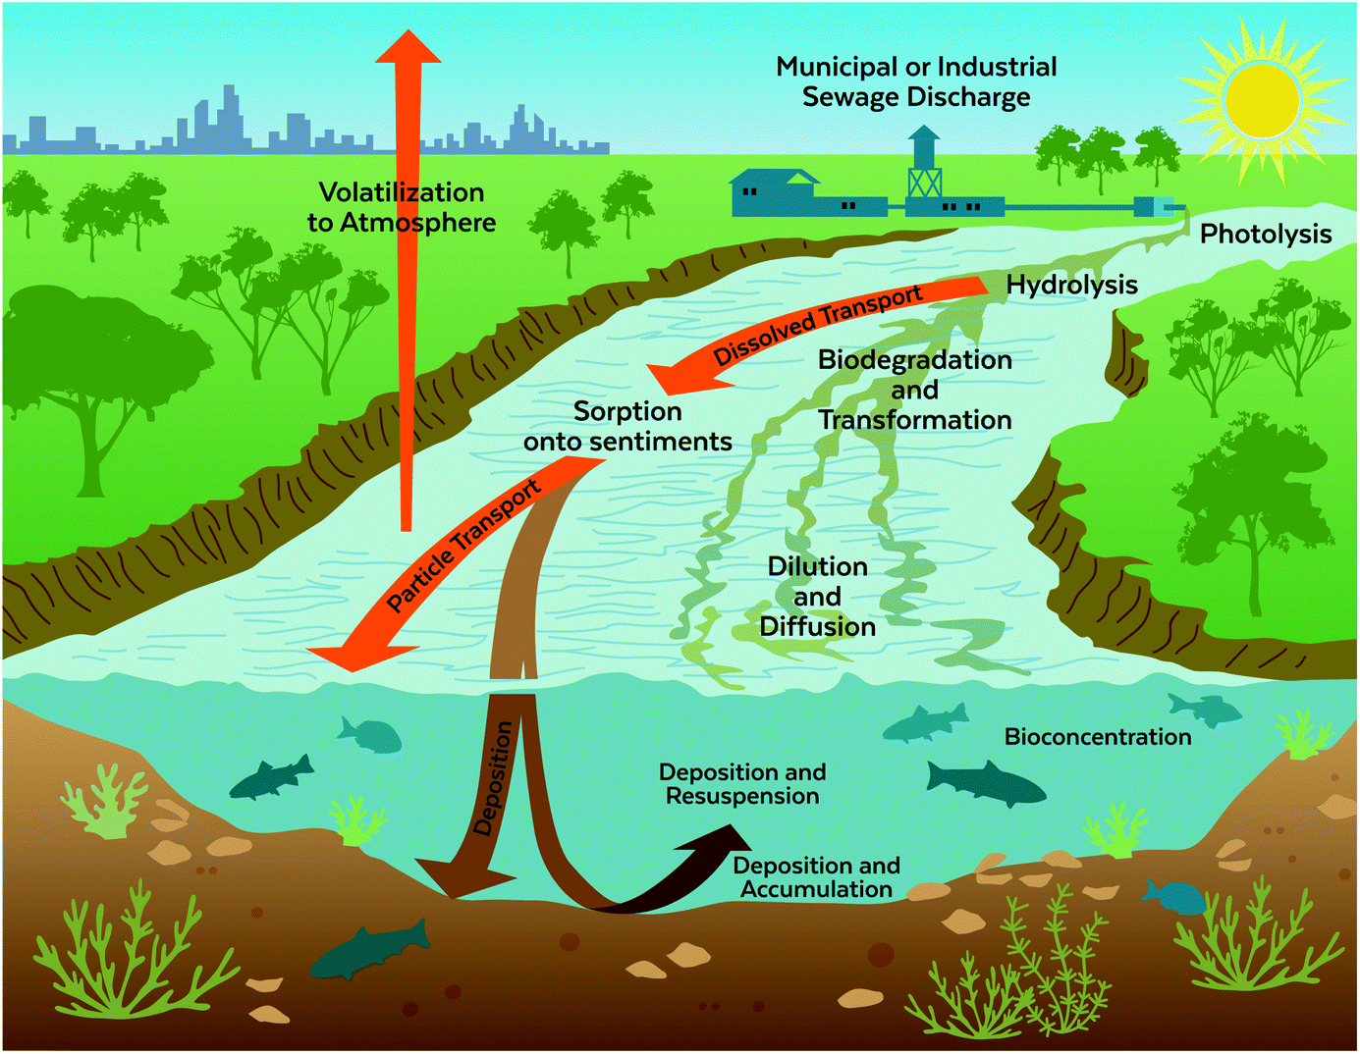
Why Does This All Matter?
Different chemical aspects overlap and interact
Variability in site conditions require specific approaches
for remediation
Fate of metals dependent
on chemistry
(Barber 1995)
KEY POINT
Chemistry is fundamental to designing and implementing remediation.
Key Chemistry
Notes:
Again, emphasize the relevance of this to the CSM as a lead-in to the next slide.

Slide 39
Presentation Overview
Overview
Key chemistry
CSM development
Environmental site assessment for metals-impacted sites
Technical challenges at NAVFAC sites
Summary and closing statements

Slide 40
CSM Objective and Definition
CSM involves environmental site assessment to characterize nature, extent, and concentration of COPCs
CSM is an integrated representation of the physical and environmental context of the site
  Biological, physical, chemical processes
  Fate and transport and exposure pathways of receptors
CSM is developed during site investigation
  Refined following changes in site conditions
COPC: contaminant of potential concern
CSM Development
Notes:
A CSM is a written or illustrative representation of the conditions and the physical, chemical, and biological processes that control the transport, migration, and potential impacts of contamination (in soil, air, groundwater, surface water and/or sediments) to human and/or ecological receptors. A CSM is intended to be refined as more data is collected.

Slide 41
CSM Uses
During investigative phase―assists in development of DQOs
During later investigation―evaluates feasibility of remedial activities and institutional controls
Throughout project―helps communicate with community, stakeholders, and regulators
DQO: data quality objective
CSM Development
Notes:
The key message here is that the CSM is a key figure to communicate risk to the key project teams and stakeholders.

Slide 42
Poll Question 2
How recently have you updated your CSM?
Options to respond:
1. Text ‘ritsn200’ to 22333 to join session
then enter response
2. Enter PollEv.com/ritsn200 in browser
3. Scan the QR code and open session in browser
CSM Development

Slide 43
Questions for CSMs with Metals
What are background levels?
What are site geochemical conditions and mechanisms that will influence fate and transport?
What sources may be present now and in the future?
What are key physical transport processes?
What is the bioavailability of the metal and what are the ecological receptors?
KEY POINT
A CSM should be a living model that is regularly revised following investigation and remedial actions.
CSM Development
Notes:
Key factors for CSMs for metals are discussed here; some are unique to metals and different than the factors for more-common organic contaminants.

Slide 44
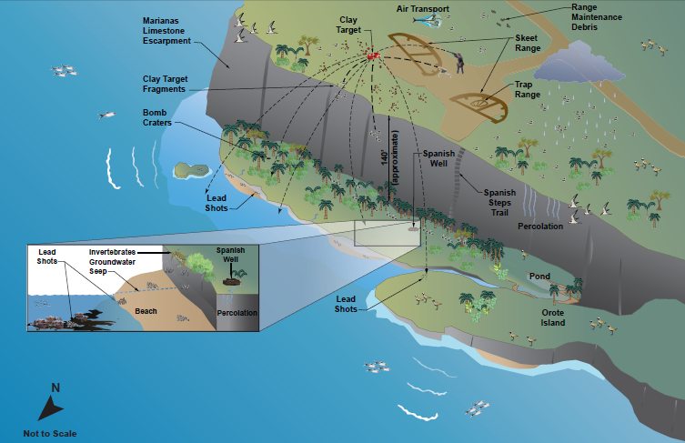
Pictorial CSM
Sources of metals at predicted locations
Fate and transport mechanisms
  Air transport
  Percolation into groundwater
Example Pictorial CSM for Skeet Range with Key Fate and Transport Mechanisms
(NAVFAC 2022)
CSM Development
Notes:
Pictorial CSMs are helpful for thinking through your site, and having a visual is great for reports.

Slide 45
Risk Assessment CSM
Primary source
Primary release mechanism
Secondary source/
exposure point
Munitions
Waste
Exposure route
Leaching from solid
Spill or
leak from containment
Receptor
Soil
Surface water
Groundwater
Direct contact
Ingestion
Inhalation
Plants
Invertebrates
Amphibians
Birds
Mammals
CSM Development
Notes:
Tabular style allows for detailed breakdown of categories. It is great as a planning tool. The process goes through identifying sources and receptors.

Slide 46
Human Risk Assessment: Case Study 1
Primary source
Primary release mechanism
Secondary source
Secondary release mechanism
Exposure media
Disposal of wastes in former evaporation pond
Leaks
Soil
Leaching
Groundwater*
Potential human receptors
(future)
Exposure route
Notes:
X: potentially complete exposure pathway
NA: not applicable or pathway is incomplete
*Resident exposed to groundwater through use as a water supply; construction worker exposed to groundwater during excavation
Resident Adult | Resident Child | Construction Worker
X | X | NA
X | X | X
NA | NA | NA
Ingestion
Dermal Contact
Inhalation
(NAVFAC Washington 2022)
CSM Development
Notes:
This example refers back to Case Study #1, where chemical wastes were discharged to an evaporating pond. This slide illustrates what a human risk assessment would look like. The take-away is that the primary exposure media is groundwater, and the exposure routes include residential scenario ingestion for both adults and children and dermal contact for residential scenario for adults, children, and construction workers.

Slide 47
Geochemical Modeling
Developmental tool helps create CSMs and design
remediation strategies
Model calculates reaction through simulations based on chemistry and physics of system
  Acid-base, complexation, dissolution and precipitation, redox, sorption, ion exchange, gas dissolution and volatilization
There are two types of models
  Equilibrium speciation modeling: what it will be (thermodynamics)
  Reactive transport modeling: how it gets there (kinetics)
CSM Development
Notes:
This slide introduces the two fundamental types of geochemical models.

Slide 48
Equilibrium Speciation Modeling
Predicts form of a metal under set conditions and mixtures
  Input site conditions and determine mobility, toxicity for CSM
Common software
  MINTEQ (free from US EPA, equilibrium speciation only)
  PHREEQC (free from USGS)
  Geochemist’s Workbench
Cd⁺⁺
Cd(OH)₂
CdS
10°C
Cd with S speciation diagram, with site conditions
pre- and post-treatment
(Geosyntec 2022)
CSM Development
Notes:
MINTEQA2 is the current version. PHREEQC version 3 is the current version. They have great available tutorials and functions.

Slide 49
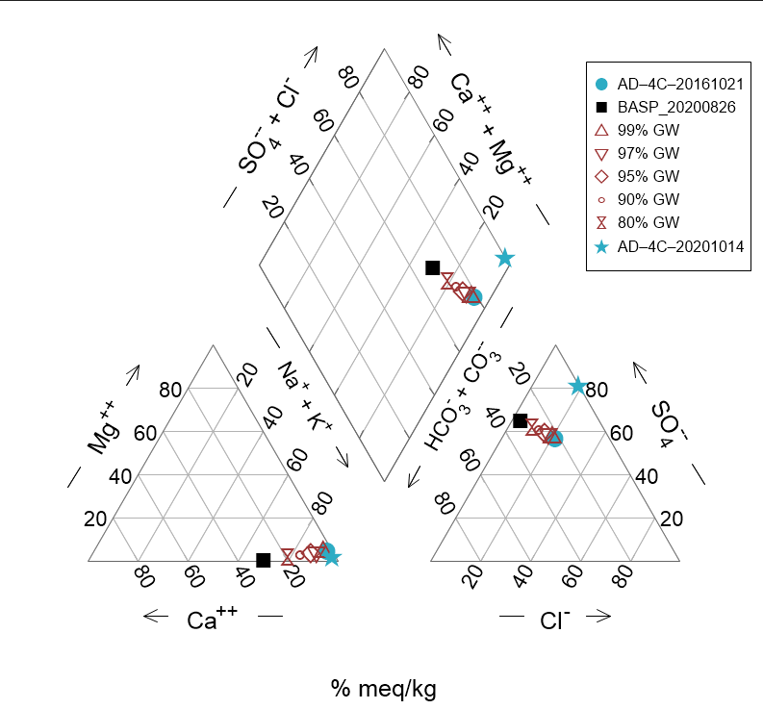
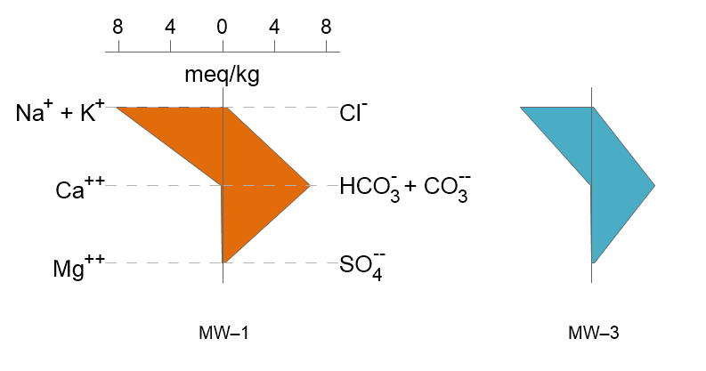
Common Geochemical Data Visualization
Piper diagram
Schoeller diagram
Stiff diagram
meq/kg: milliequivalent(s) per kilogram
meq/L: milliequivalent(s) per liter
(Geosyntec 2023)
CSM Development
Notes:
Water chemistry diagrams for comparison of different samples showing how a source may or may not be affecting a certain well.

Slide 50
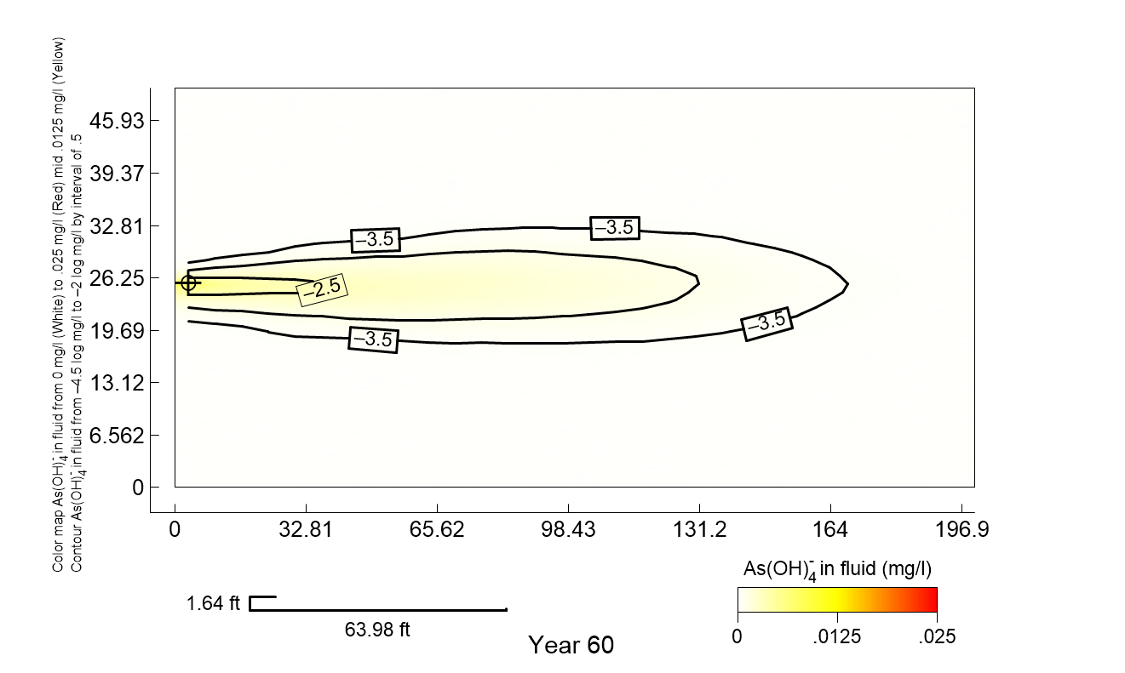
Reactive Transport Modeling
Computer simulations to calculate reactions within flow and time
  Varied levels of complexity and scale
Common software
  TOUGHREACT and variations
  PHREEQC (free from USGS)
  Geochemist’s Workbench
  MODFLOW 6 (free from USGS) hydrologic, but can incorporate reactive transport
Arsenic plume extent model with demo data
CSM Development
Notes:
Kinetic models are more complex and require a more sophisticated skill set. It’s important to identify a contractor with this specific expertise.

Slide 51
Break

Slide 52
Presentation Overview
Overview
Key chemistry
CSM development
Environmental site assessment for metals-impacted sites
Technical challenges at NAVFAC sites
Summary and closing statements

Slide 53
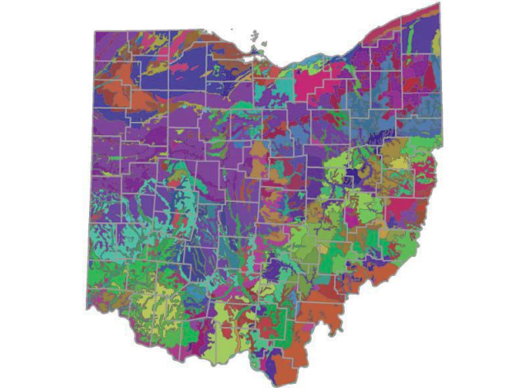
Background Considerations
Generalized soil map for the State of Ohio
(Ohio EPA 2013)
Natural background vs anthropogenic background
  Soil and groundwater
  Point and nonpoint sources
Methods for evaluating background soil
  View state-specific studies and established values
    Many states have soil-specific data, often by county
  Identify and collect samples from reference area
    Develop sampling plan and statistical approach for comparison
    Use available tools, e.g., US EPA ProUCL
Arsenic
Barium
Cadmium
Chromium
Lead
Mercury
Nickel
Selenium
Thallium
20.7 mg/kg
163 mg/kg
0.789 mg/kg
16.4 mg/kg
41.5 mg/kg
0.081 mg/kg
36.4 mg/kg
1.07 mg/kg
0.743 mg/kg
Environmental Site Assessment
Notes:
In contrast to some common organic contaminants, like chlorinated solvents, metals have natural background concentrations in soil, sediment, and most natural water.

Slide 54
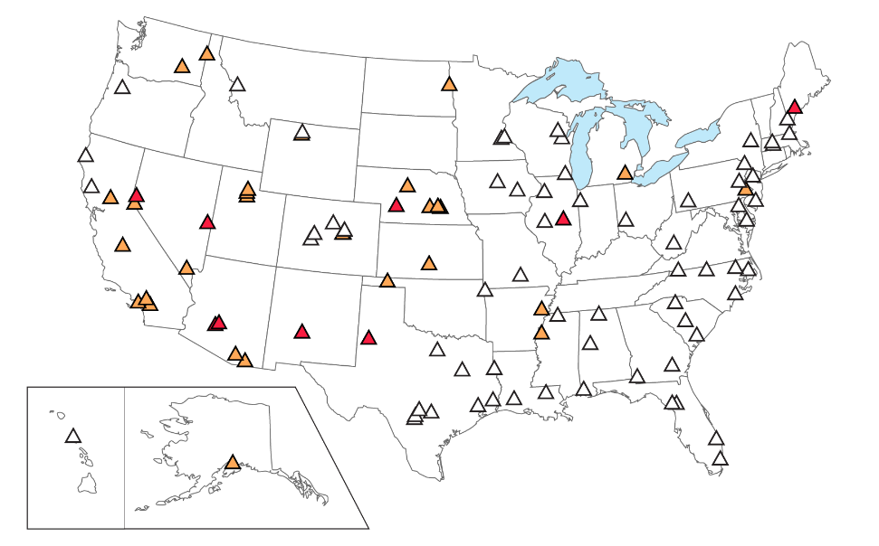
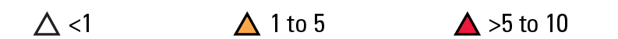
Background Considerations
Methods for evaluating background groundwater
  Use available databases (e.g., USGS National Water Quality Assessment)
  Be mindful of your site conditions
    Upgradient land uses
    Local geology/hydrogeology
    Features (incorporate into sampling plan)
The US EPA “How’s My Waterway” tool
  Available at https://mywaterway.epa.gov/
  Compiles information on a watershed scale, including water quality monitoring
Median arsenic concentrations in micrograms per liter. Each symbol represents a study network of 20 to 30 wells, mostly domestic supply wells
(DeSimone 2010)
Environmental Site Assessment
Notes:
Sometimes it can be challenging to determine where or how to identify accepted background concentrations. Often working with your regulators on a plan to determine site-specific values for soil, sediment, and groundwater is the most advisable approach, especially for areas where historical operations (not related to current operations) or upgradient operations could be affecting your site.

Slide 55
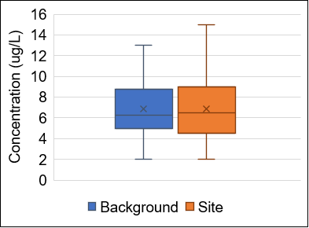
Background Best Practices
Select reference site, develop sampling plan, and determine statistical approach for comparison of background to site data
Gather background as early as possible
Be sure CSM and risk assessment identify all COPCs
Eliminate all natural and anthropogenic COPCs below background even if they exceed screening levels
Data plot to compare arsenic background and site data sets
(NAVFAC 2022)
KEY POINT
Remedial action levels should not be set below site-specific background and may exceed screening levels.
Environmental Site Assessment
Notes:
Key point example is that arsenic background is frequently above risk-based thresholds in soil and groundwater at many sites.

Slide 56
Building Your Sampling Plan
Background
Surface water
Consider data types needed
  Soil, groundwater, surface water
  Potential interactions
Select locations based
on CSM and expected
transport mechanisms
Ensure you go sufficiently
far downgradient
Groundwater
Soil
Vertical Delineation
Point Source
Downgradient Boundary Coverage
Horizontal delineation
Groundwater Flow
Example sampling plan for multiple media
Environmental Site Assessment
Notes:
This is an idealized example of how you would use your CSM to establish a sampling strategy for site investigation, including incorporating background sampling.

Slide 57
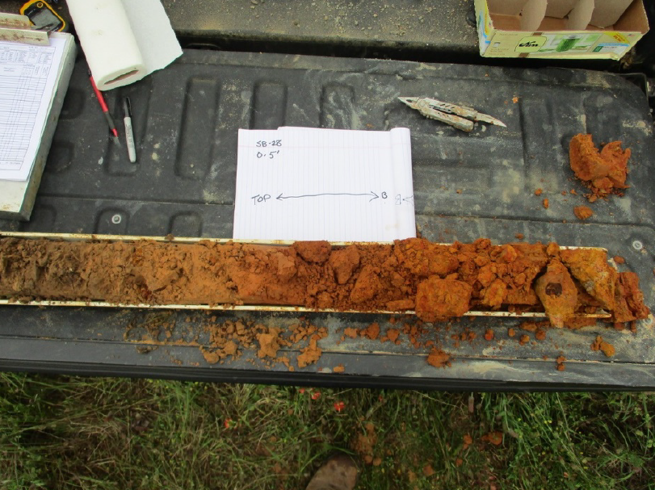
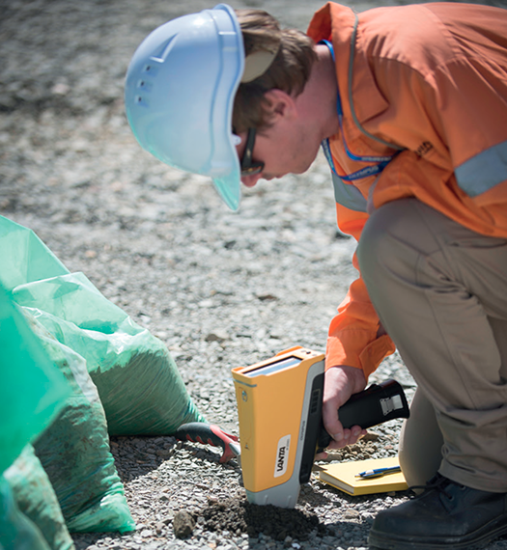
Soil Assessment
Field assessments
  Soil cores and logs
  Bulk chemical composition (e.g., XRF)
Laboratory assessments
  Ion exchange capacity
  Partitioning by SEP
  Mineralogy by XRD
Split-spoon soil sample
(Geosyntec n.d.)
Handheld XRF meter
(Mining Magazine 2023)
SEP: sequential extraction procedure
XRD: x-ray diffraction
XRF: x-ray fluorescence
Environmental Site Assessment
Notes:
These are different methods of soil assessment. SEP partitions trace metal into fractions: exchangeable, bound to carbonates, bound to Fe-Mn oxides, bound to organic matter, and residual.

Slide 58
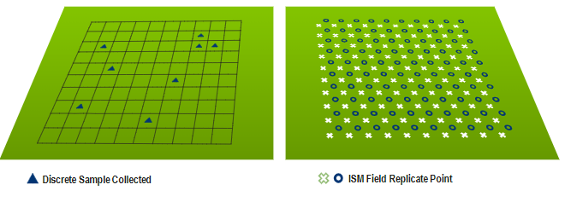
Incremental Sampling Methodology
Discrete sampling
Incremental sampling
ISM components
  Sample design
    Dependent on study goal
    Number and size of DUs, replicate ISM samples, and increments for each ISM sample
  Field sample collection
  Laboratory sample processing and analysis
  Statistical analysis for
  risk assessment
Discrete sample collected
ISM field replicate point
Uses structured sampling protocol to reduce data variability
Uses DUs to get a mean contaminant concentration
Requires established DQOs and CSM
DU: decision unit
(Neil 2021)
Environmental Site Assessment
Notes:
ISM is not applicable to all sites. If you determine that it can be used at your site, it can be an incredibly useful tool.

Slide 59

ISM: Benefits and Limitations
Useful approach for
  Determining mean rather than precise spatial characterization
  Meeting requirement allowed by regulatory agency
  Avoiding variability of discrete sampling
  Meeting DQOs with fewer total samples (analytical savings overcome additional sampling costs)
Not ideal for
  Contaminants > 2 feet depth
  Open-ended investigation
  Overall extent/type of contamination is unknown
(Image from Microsoft PowerPoint 2023)
Environmental Site Assessment
Notes:
Don’t go fishing with ISM!

Slide 60
Guidance on ISM Implementation
Depends on selection of DUs
Consult previous case studies and guidance for design
  USACE (2013) ISM Methodology for
  Metallic Residues
  RITS (2021) Applying ISM
  at Navy Sites
Example: DUs based on cleanup area
  Known Pb hotspot to be excavated
  Mean concentration to decide if additional excavation needed
DU 2
DU 1
Pb
DU 3
DU 4
(Neil 2021)
USACE: United States Army Corps of Engineers
Environmental Site Assessment
Notes:
A useful reference is US Army Corps of Engineers Incremental Sampling Methodology for Metallic Residues, with additional information and case studies. Also see previous RITS on this topic, as well as ITRC guidance.

Slide 61
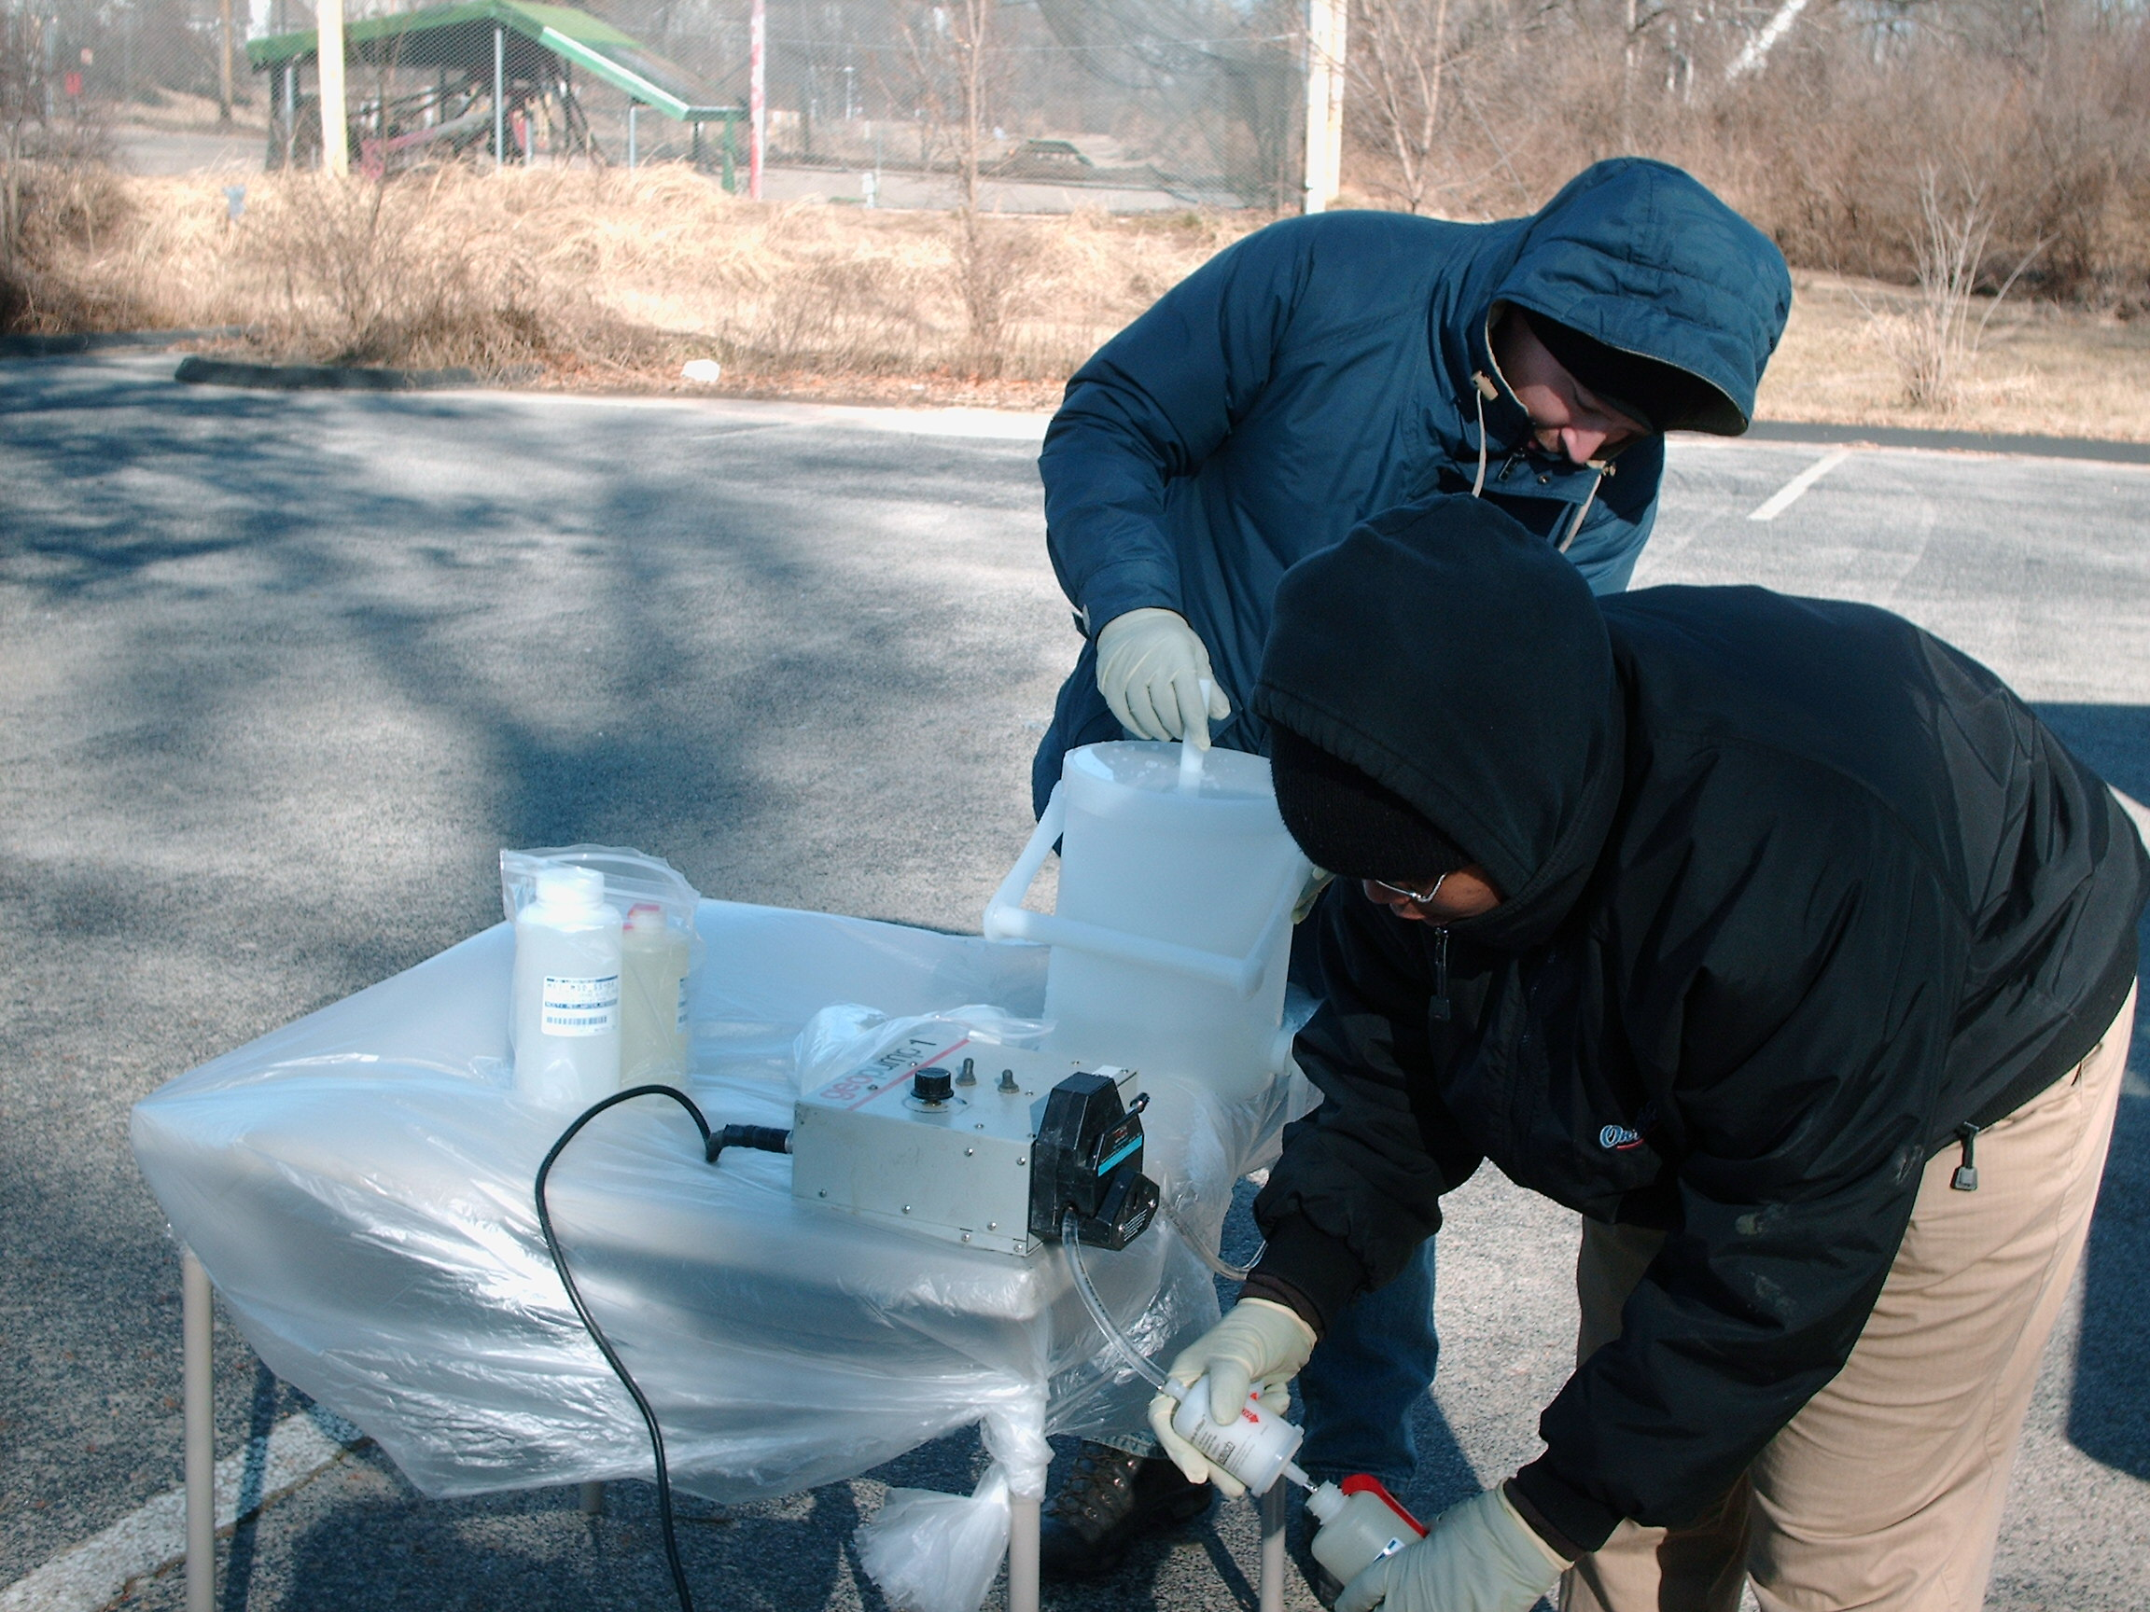
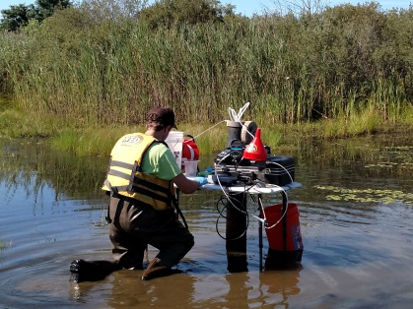
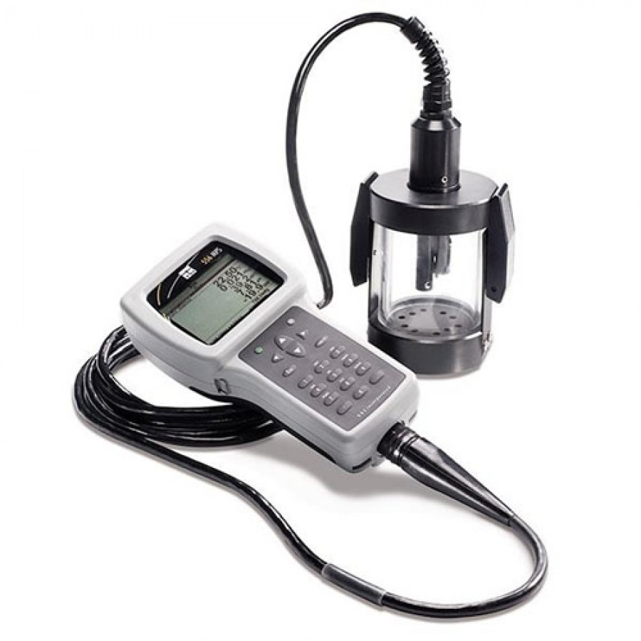
Water Quality Assessment
Groundwater/surface water
  Sampling protocols for
  redox-sensitive species
Field parameters
  pH, Eh, DO, specific
  conductance, temperature
Laboratory methods
  Total vs dissolved metals
  ICP-ES (most metals)
  CVAAS (mercury)
  Ion chromatography (anions)
  Microbiology analyses
Clean sampling for trace metals
(Lows n.d.)
Water quality meter with flow cell
(GFS 2023)
ICP-ES: inductively coupled plasma – emission spectroscopy
CVAAS: cold vapor atomic absorption spectroscopy
Environmental Site Assessment
Notes:
These are different considerations for water quality assessment of surface water and groundwater.

Slide 62

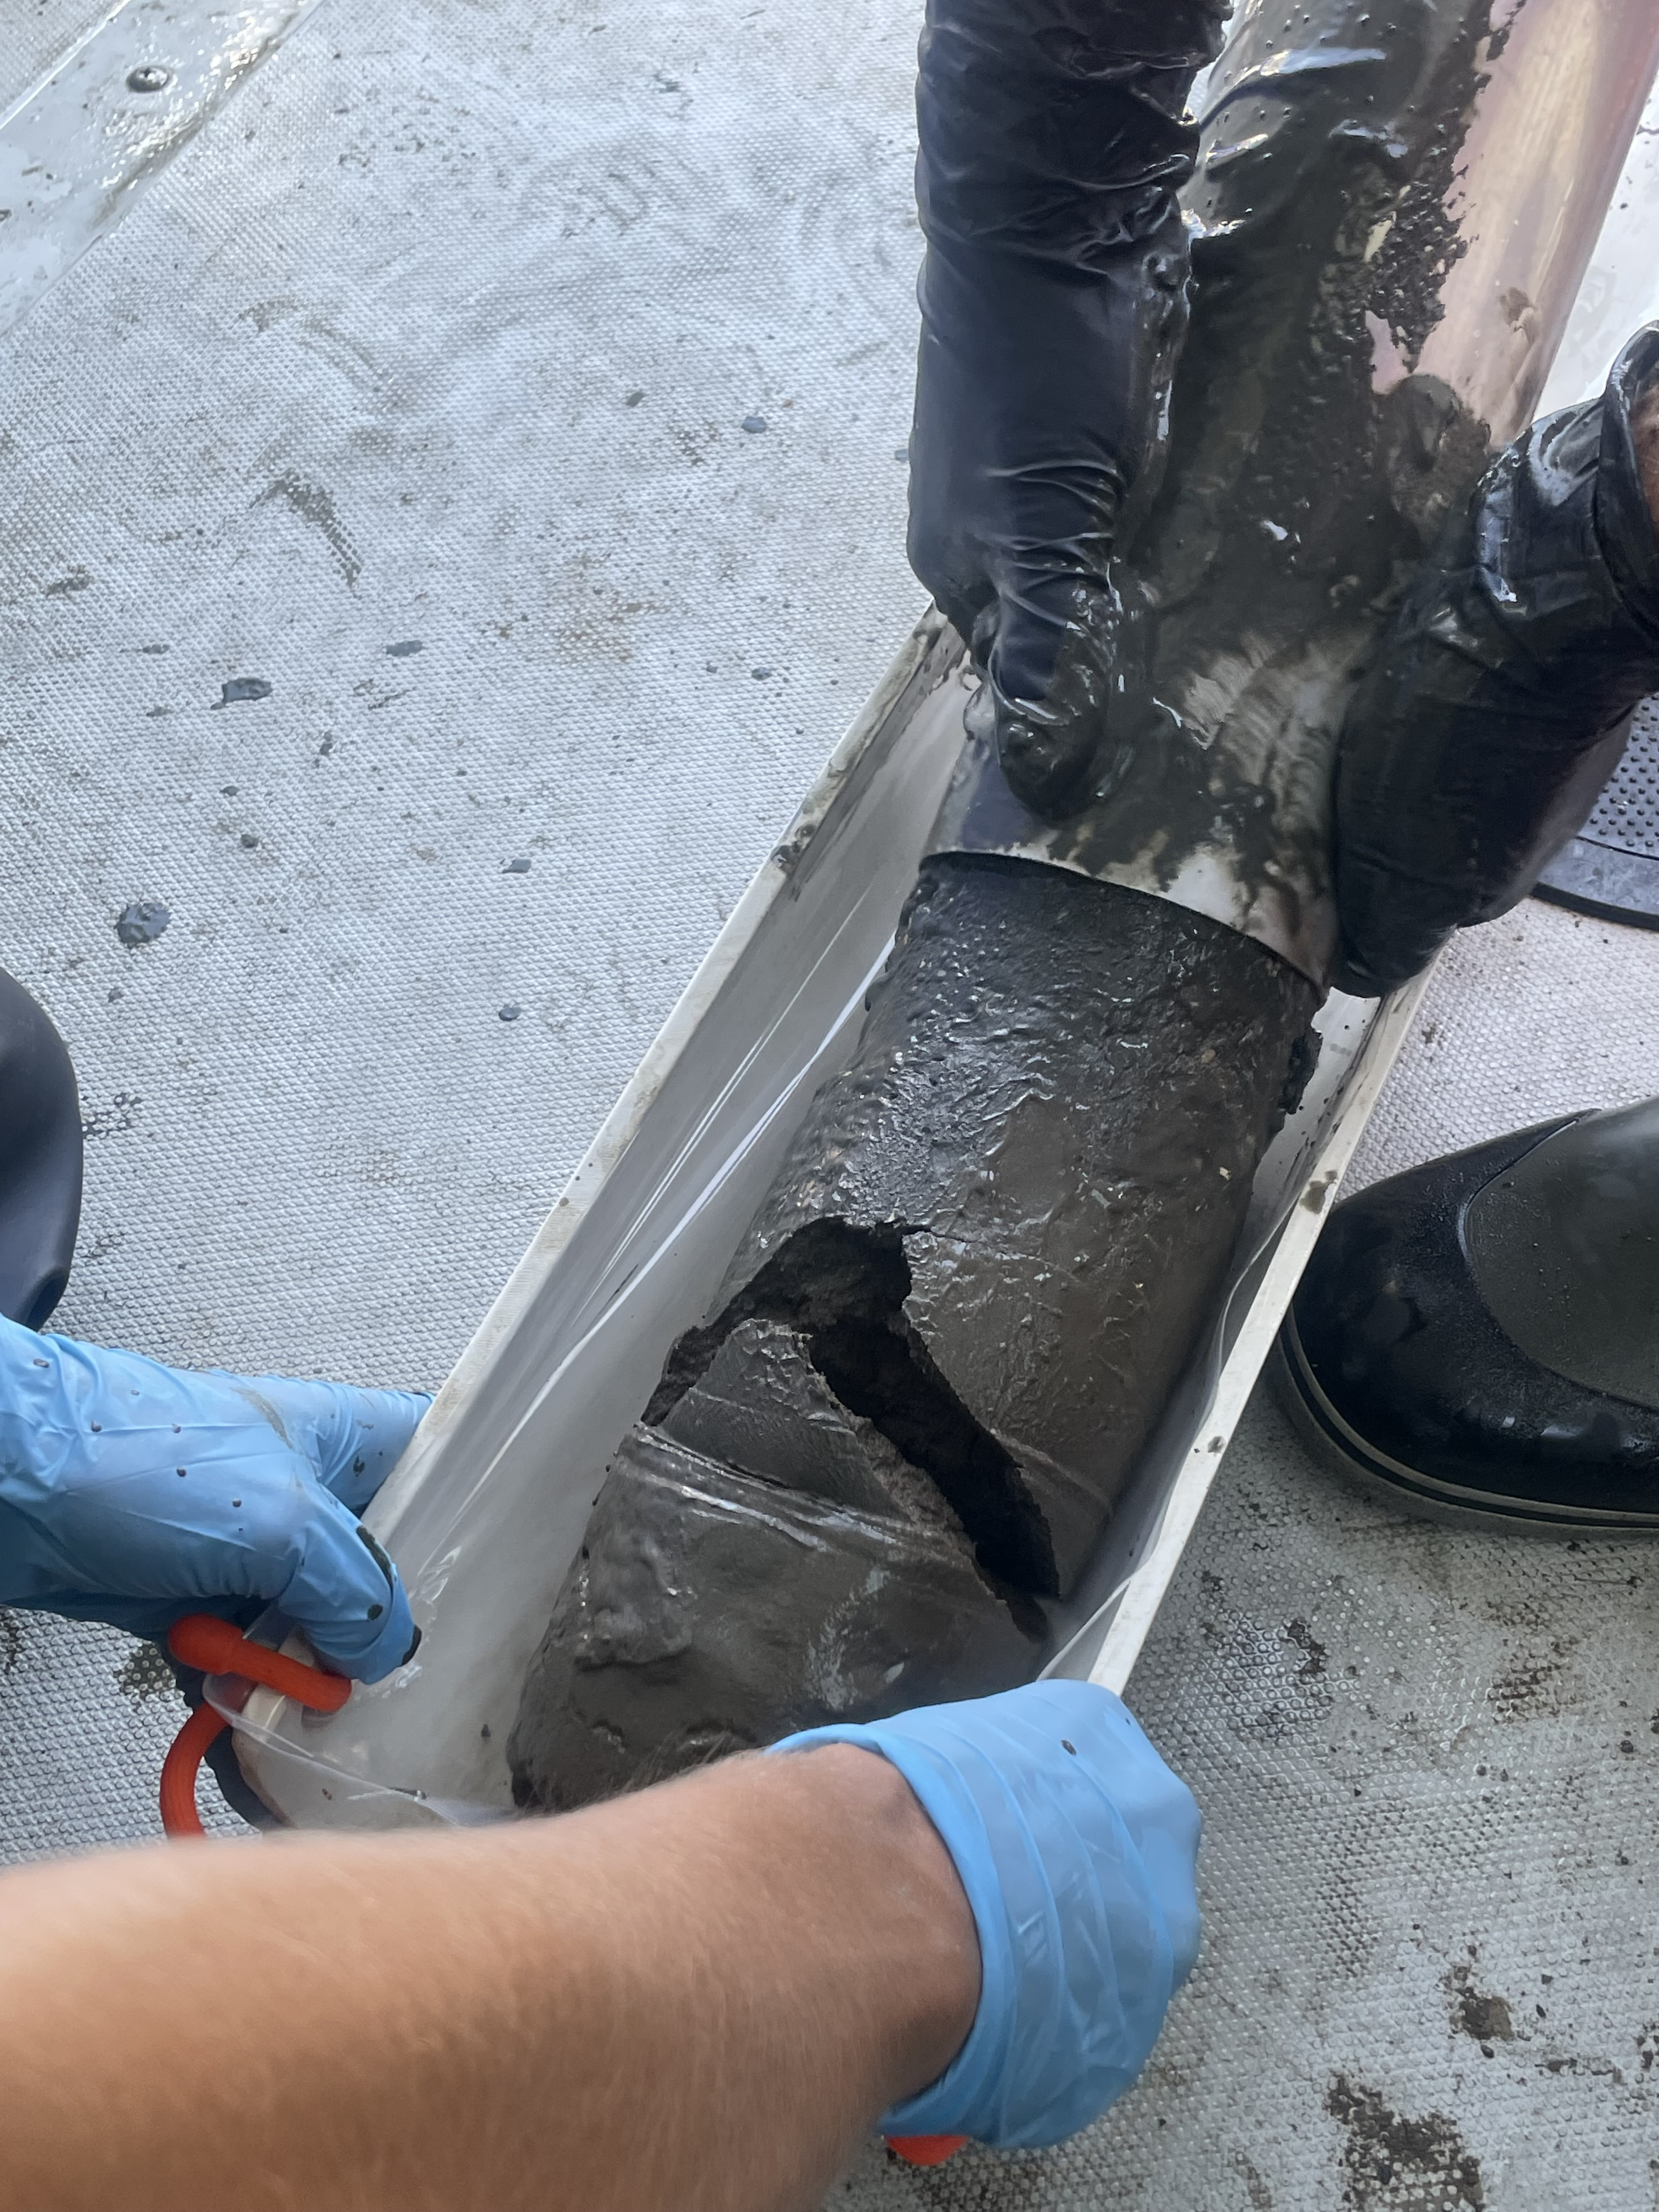
Sediment Assessment
Field sampling
  Coring
  Porewater samplers (active or passive)
Laboratory assessment
  SEM-AVS: assesses potential for metals in sediment to cause toxic effects in organisms
Sediment coring
(Geosyntec n.d.)
Passive sampler
(SiREM 2023)
SEM-AVS: simultaneously extracted metals – acid-volatile sulfide
Environmental Site Assessment
Notes:
There are a number of similar soil and water techniques used for sediment assessment, but there are some remaining sediment differences.

Slide 63
Statistical Analysis Tools
Outlier screening
Robust data set building for comparing background and site samples
Mann-Kendall tests for
trend significance
Navy and US EPA guidance documents and available tools (e.g., US EPA ProUCL)
Example outlier test with demo data
mg/L: milligram(s) per liter
Environmental Site Assessment
Notes:
Let’s not overlook the suite of statistical tools available for analysis of temporal and geospatial data sets. The total review of available tools and guidance documents is beyond the scope of this presentation; however, it is important to be mindful to include these in your environmental site assessments.

Slide 64
Case Study 2: Application of ISM to
Estimate Metals and PAHs in Surface Soil at a Former Small Arms Firing Range
Naval Base Guam
NAVFAC 2019

Slide 65
Site Overview
Background
Former trap and skeet range (66 acres)
Firing range area
Range maintenance
Fringing reef and islands
Contaminants of concern
Metals and PAHs in soil and groundwater
Pb, Sb, As, Cd, Cu, Ni, Zn
Investigative approach
Need additional data to characterize nature and extent of contamination
Follow Hawaii guidance for ISM sample collection and application
PAH: polycyclic aromatic hydrocarbon
Environmental Site Assessment: Case Study 2
Notes:
Moving to Case Study #2: the application of ISM to estimate metals and PAH concentrations at a SAFR.

Slide 66
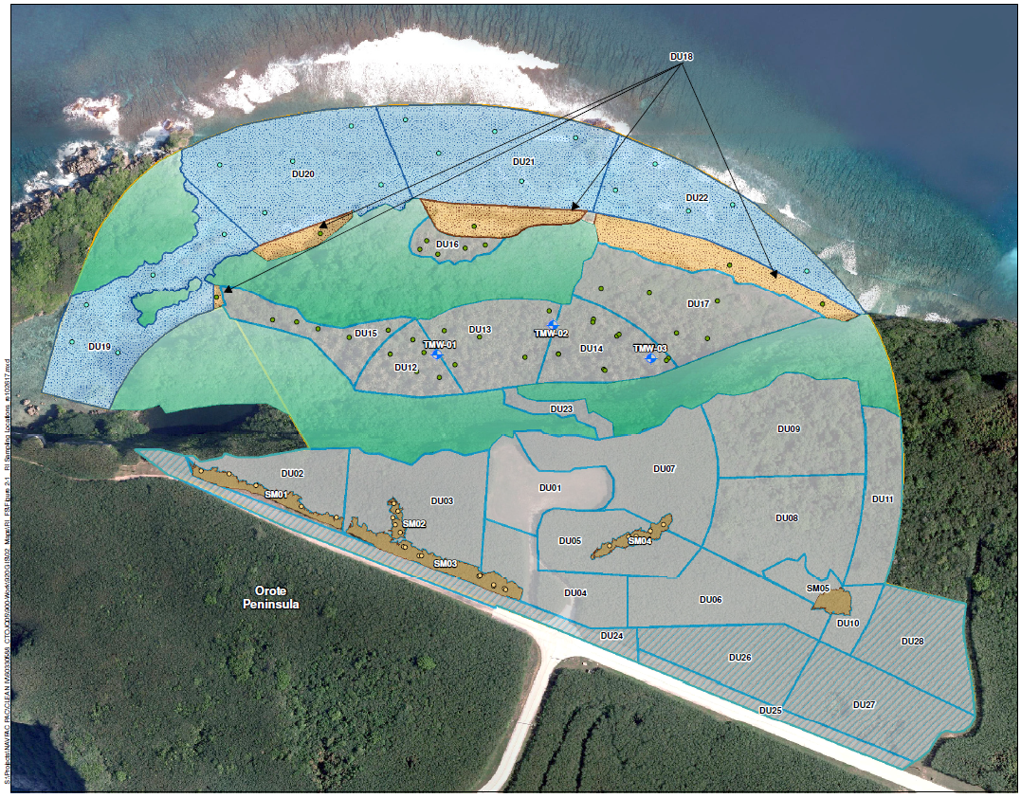
Site Map with 25 DUs
Use ISM in 25 DUs with targeted discrete and composite sampling
Characterize risk based on mean contamination in each area
Remedial investigation sampling locations within DUs (NAVFAC 2019)
Environmental Site Assessment: Case Study 2
Notes:
The photo in this slide shows how the SAFR at Guam was divided into different decision units (DUs).

Slide 67
Best Practices
Include TOC, ion exchange capacity, and pH to assess potential transport mechanisms
Collect total and dissolved concentrations of metal to evaluate relative COPCs for each sample
  Dissolved << total metals, meaning most are colloidal
Use two-phase sampling approach for data gap coverage
Conduct leaching tests for all metals in surface and subsurface samples
Conduct bioavailability testing to characterize potential exposure to ecological receptors
TOC: total organic carbon
Environmental Site Assessment: Case Study 2
Notes:
In terms of best practices, this slide intends to illustrate that, as an RPM, one must consider sampling requirements that include not only COPCs but also other parameters that would affect potential attenuation processes for your specific metal.

Slide 68
Poll Question 3
What other techniques or methods you have seen or used for metals assessment?
Options to respond:
1. Text ‘ritsn200’ to 22333 to join session
then enter response
2. Enter PollEv.com/ritsn200 in browser
3. Scan the QR code and open session in browser
Environmental Site Assessment

Slide 69
Presentation Overview
Overview
Key chemistry
CSM development
Environmental site assessment for metals-impacted sites
Technical challenges at NAVFAC sites
Summary and closing statements
Notes:
The common technical challenges for metals at NAVFAC sites relate to SAFRs and groundwater with elevated background conditions or changing redox conditions.

Slide 70
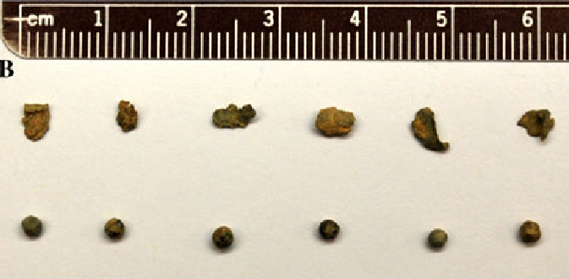
SAFRs
More than 3,000 active SAFRs
Heterogeneous distribution of metals residues
Lead primary focus due to prevalence and relative toxicity
Additional metals present
  Pb, Cu, Zn, tungsten (W), As, Sb, and Ni
Spent bullets and lead shot primary source of metal (can fragment and disintegrate over time)
Fragments > 2 mm in diameter typically excluded from soil samples, but support ecological risk assessment
Bullet fragment size variation
(Kerr 2011)
mm: millimeter(s)
Technical Challenges at NAVFAC Sites
Notes:
This slide provides a good summary of high-level considerations for SAFRs

Slide 71
Lead Fate and Transport
Site characterization to understand potential mechanisms
  Total organic content
  pH
  CEC
    High CEC and organic matter, metal ions will bind to soil
    Low CEC/sandy soils, metal ions
    may be transported into surface water or groundwater
Source characterization
  Bullet type, fragmentation (smaller particles means more corrosion and leaching of metal ions)
Bioavailability
  Increases with decreasing
  particle size
  Is variable depending on lead mineral
    Start as Pb²⁺
    Sulfate < Oxide < Carbonate
CEC: cation exchange capacity
Technical Challenges at NAVFAC Sites
Notes:
Bioavailability note: birds may get acute lead exposure from fragments that they used as dietary grit, so it is important to consider ecological risk, especially on coastal bases.

Slide 72
Key Considerations for SAFRs
Metals distributions are heterogeneous but can be mapped by past operations
Range design and maintenance operations should guide
initial CSM
Contaminants may migrate
  Depth of groundwater
  Chemistry
  Proximity to
  surface water
Example Pictorial CSM for Skeet Range with Key Fate and Transport Mechanisms
(NAVFAC 2022)
Technical Challenges at NAVFAC Sites
Notes:
This is an example and reminder to revisit your CSMs iteratively as you conduct further site assessments.

Slide 73
Lead Remediation Considerations
Cleanup criteria driven by human health risk assessment
Exposure to lead evaluated as PbB concentrations
  US EPA RSLs
    400 mg/kg for residential
    800 mg/kg for industrial/commercial
    California EPA levels
    80 mg/kg for residential
    320 mg/kg for industrial/commercial
Goal to reduce mobility
  Naturally constrained by high clay, high organic matter
  Addition of chemical stabilization agent and disposal of excavated soil (See Case Study 1: Naval Support Facility Dahlgren)
PbB: blood lead
RSL: regional screening level
Technical Challenges at NAVFAC Sites
Notes:
Keep in mind that these RSLs are continuously updated.

Slide 74
Case Study 3: Site Investigation and
Removal Action for Lead in Soil at
Small Arms and Skeet Ranges
Naval Support Facility Indian Head
Indian Head, Maryland
NAVFAC Washington 2021a

Slide 75
Site Overview
Background
Former rifle, skeet, and trap ranges at Naval Support Facility Indian Head in Maryland
Contaminants of concern
Lead in surface and subsurface soil at shotfall areas (> 400 mg/kg project action limit)
Other metals and PAHs
Technical Challenges at NAVFAC Sites: Case Study 3
Notes:
The next case study covers a different SAFR. The lead screening level is from the Maryland Department of Environment (MDE).

Slide 76
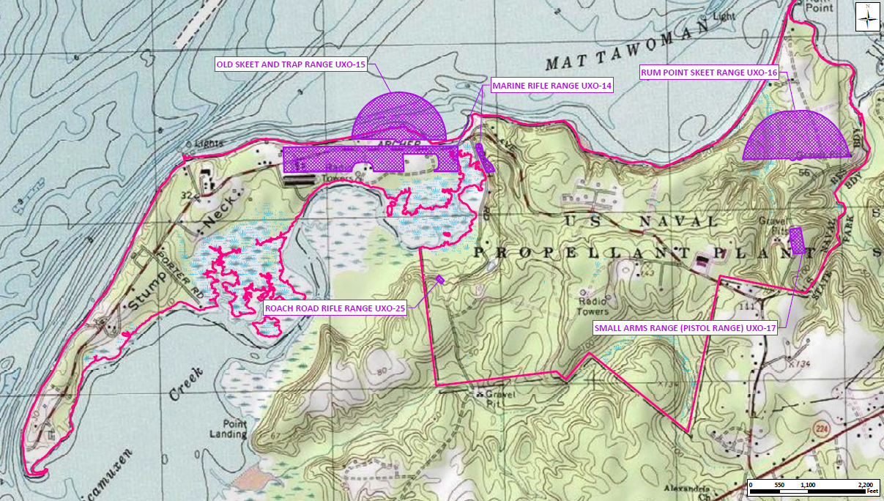
Site Map
Old Skeet and Trap Range UXO-15
Rum Point Skeet Range UXO-16
Marine Rifle Range UXO-14
Roach Road Rifle Range UXO-25
Small Arms Range (Pistol Range) UXO-17
Small arms/skeet range location map
(NAVFAC Washington 2021a)
Technical Challenges at NAVFAC Sites: Case Study 3
Notes:
The total area of the site is 30.4 acres. During its estimated period of use, 1911 to 1918, the range was used for small arms (.30-caliber) rifle training. Two sets of firing lines, one for each target berm, were located at 100- meter intervals over a 1,000-meter span. Targets were mounted on each berm and held in place by a series of chains and mechanical supports. Bullets that were fired low and missed the targets tended to accumulate in the target berm soil at the base of the targets. Bullets that were fired high and missed the targets, or hit the targets and passed through, continued down range and accumulated in the Hillside Impact Area. The site-specific contaminant of concern (COC) is lead in surface and subsurface soil.

Slide 77
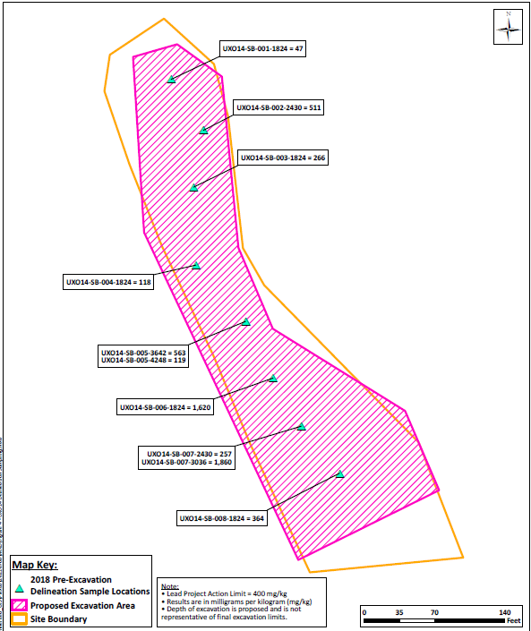
Investigation and Remediation
Site characterization
  XRF during Phase I
  Laboratory compared to field
Selected remedial action
  Excavation and disposal
    Lead-contaminated soil in a RCRA Subtitle D−permitted landfill must be stabilized.
    Chemical stabilization accomplished by adding Blastox® 215
Handheld XRF meter
(Mining Magazine 2023)
UX0 14 preexcavation lead delineation
sampling results
(NAVFAC Washington 2021a)
Technical Challenges at NAVFAC Sites: Case Study 3
Notes:
Here is one subsection of the site given as an example, showing the excavation area (pink) and the site boundary (orange outline). To characterize the site, they used handheld XRF meters to identify lead level, and compared the XRF data to a smaller subset of laboratory data.

Slide 78
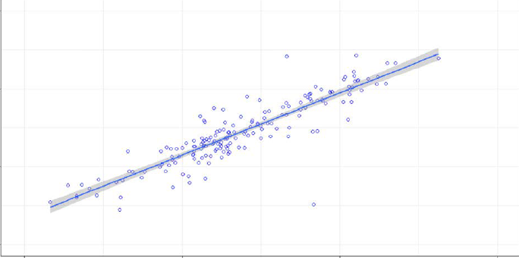
Lead Screening Method
Screened by XRF field screening and FBL analysis
Regression equations for data at sites used to predict lead concentrations in areas with XRF data alone
3.0
2.5
2.0
1.5
XRF Avg. Pb Concentrations (mg/kg)
1.5 2.0 2.5 3.0
Lab Pb Concentration
(mg/kg)
Example regression line for lab Pb and XRF Pb concentrations
(NAVFAC Washington 2020)
FBL: fixed-based laboratory
Technical Challenges at NAVFAC Sites: Case Study 3
Notes:
The regression line demonstrates the effectiveness of handheld XRF as a screening tool to determine lead concentrations in soils.

Slide 79
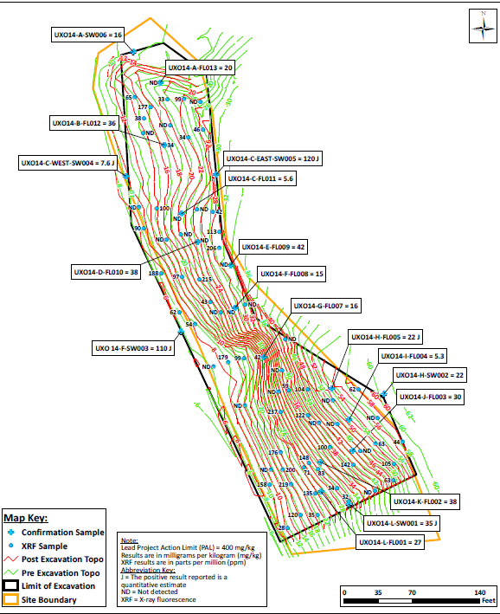
Lead Screening Data
XRF field screening combined with laboratory analysis of subsection of total samples
Results defined lateral and horizontal extent of contamination, informing excavation extent
UX0 14 XRF screening and lead confirmation sampling results
(NAVFAC Washington 2021a)
Technical Challenges at NAVFAC Sites: Case Study 3
Notes:
Figures shows those little blue dots, which are all field XRF. These are compared to labeled sites, which are laboratory validation samples. The lead data generated for samples that were analyzed both in the field using XRF and at the field-based laboratory (FBL) were used in regression analyses that were conducted to evaluate the strength of the correlation between the FBL analytical data and the XRF screening data. Results of the regression analyses indicated that the correlation between the on-site XRF and off-site FBL lead data was statistically acceptable.

Slide 80
Removal Action
Process
  Excavated impacted soil in 250-cubic-yard increments
  Characterized waste to determine need for chemical stabilization
  Treated soil with lead concentrations above 5 mg/L
  Disposed of soil off-site
Chemical Stabilizer Treatment
  pH adjusted to change lead form (lead oxide, carbonate, or hydroxide to insoluble lead silicate)
  Heavy metals stabilized (Pb, Cd, Ba, Zn, and Cu)
  Dosage depended on leaching tests
  Blastox® 215 selected (dry, fine-grain calcium silicate)
Technical Challenges at NAVFAC Sites: Case Study 3

Slide 81
Summary
Best Practices
Lessons Learned
  CSM with firing and target locations, ballistics behavior used to identify spatial patterns of COPCs and guide sample collection
  Sampling and analysis plan covered detailed procedures
  Statistical testing completed (per US EPA SW-846 Method 6200)
  XRF is reliable for field screening
  Provide enough pairwise data with lab analysis to demonstrate robust statistical relationships
  Reduce laboratory costs with sample collection planning
Technical Challenges at NAVFAC Sites: Case Study 3
Notes:
Based on the results of the preexcavation sampling and XRF field screening in the lead excavation areas, an estimated total of approximately 5,146 cubic yards (7,589 tons) of contaminated soil was removed.

Slide 82
Guides for SAFRs Investigation and Management
SAR-QAPP Tool (DOD 2013)
  Systemic process for COPCs
    Transport pathways
    Bioavailability
  Info and examples to complete QAPP worksheets
Army Small Arms Training Range Environmental BMPs Manual (USAEC 2005)
  Metals and speciation at SAFR sites, including fate and transport
BMP: best management practices
SAR-QAPP: small arms range quality assurance project plan
USAEC: United States Army Environmental Command
Technical Challenges at NAVFAC Sites
Notes:
If you have a SAFR to investigate, please keep in mind there are additional guidance documents for reference.

Slide 83
Metals Above Background Without Source
Statistical analysis with site understanding through CSM
Method
  Evaluate geology, hydrogeology, and sources
  Evaluate geochemical conditions
  Conduct spatial and temporal groundwater data analysis
Guidance for Environmental Background Analysis Volume III: Groundwater (NAVFAC 2004)
  Monitoring and statistical approaches
  Procedures for selecting well locations, evaluating data, and site characteristics
  References to relevant regulatory standards
(NAVFAC 2022)
Technical Challenges at NAVFAC Sites
Notes:
At some sites, there may be metals concentrations in groundwater that cannot be attributed to a known source or historical release. Background determinations or statistical evaluations will not always provide the information necessary for attribution to natural sources or natural variability (i.e., seasonality or tidal influence).

Slide 84
Case Study 4: An Evaluation of the Occurrence of Arsenic in Groundwater at the Washington Navy Yard
Washington Navy Yard
Washington D.C.
NAVFAC Washington 2021b

Slide 85
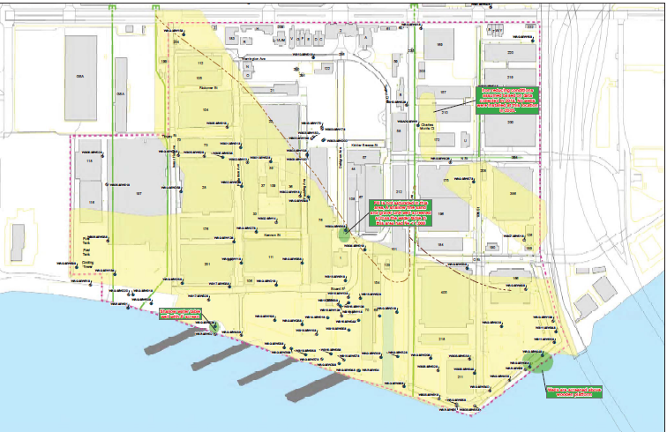
Groundwater Challenges
Arsenic is above background without an attributable source
Arsenic mobilized by changing site redox conditions
Shaded area here notes iron-reducing conditions
(NAVFAC Washington 2021b)
Technical Challenges at NAVFAC Sites: Case Study 4
Notes:
This site has dissolved arsenic in the shallow aquifer at concentrations above background but no attributable source. This site also has known releases of petroleum hydrocarbons as well as chlorinated solvents.

Slide 86
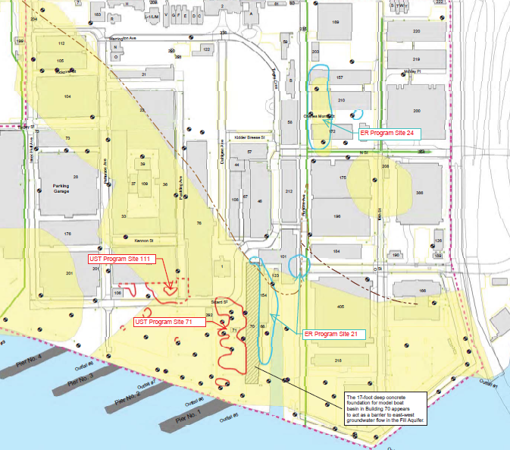
Known Areas of Solvent Releases
Known releases of chlorinated solvents to the fill aquifer
Known releases of petroleum hydrocarbons to the fill aquifer
Both types of groundwater impacts can drive lower ORP and cause iron reducing conditions
(NAVFAC Washington 2021b)
Technical Challenges at NAVFAC Sites: Case Study 4
Notes:
However, the known releases of petroleum hydrocarbons and chlorinated solvents cannot explain the sitewide reducing conditions (low ORP and high dissolved iron).

Slide 87
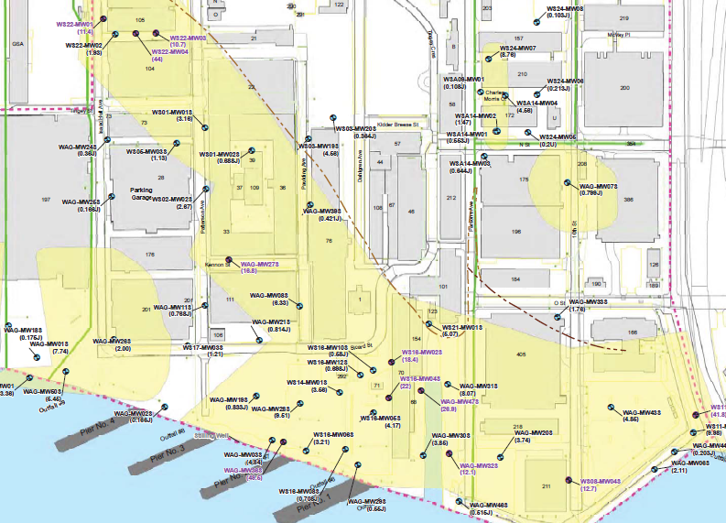
Area of Elevated Arsenic in Groundwater
Arsenic in excess of MCL, downgradient of known release areas, and all within the fill aquifer
Fill material used to develop the native Anacostia marsh lands suspected as containing arsenic and high native organic carbon
Arsenic detected in almost all fill soil samples (504 of 521) at concentrations up to 83.6 mg/kg
Indicates groundwater arsenic >10 µg/L
(NAVFAC Washington 2021b)
Technical Challenges at NAVFAC Sites: Case Study 4
Notes:
While the co-contaminants were cited as a factor in causing reducing conditions, the larger area of the dissolved iron/arsenic was suspected to be due to natural conditions and the fill material that was used for waterfront development (high organic carbon and containing arsenic).

Slide 88
Summary
Best Practices
Lessons Learned
  Consider site history
  Evaluate all possible sources and background
  Elevated metals concentrations in groundwater may not be related to site releases
  Need to consider sites wholistically to understand combined effect of
  co-contaminants on evolution of site gradients
Technical Challenges at NAVFAC Sites: Case Study 4

Slide 89
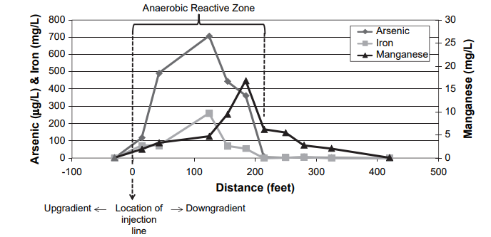
Metals Mobilized by Changing Redox
Redox change is a side effect of contamination and treatment
  Complex interaction of in situ chemical and biological process treatment with solids
Anaerobic and reducing conditions can induce dissolved iron, manganese, and arsenic
  Caused by degradation of organic contaminants (hydrocarbon spill)
  Caused by deliberate treatment for another remedy
Dissolved metals concentrations
through an engineered anaerobic in situ reaction zone
(Suthersan and Horst 2008)
Technical Challenges at NAVFAC Sites
Notes:
Metals can be mobilized by changing redox conditions. Iron, manganese, and arsenic can fall back out into solid phase once outside of the anaerobic zone, as shown in the image. It is necessary to verify proximity to potential impacts within that elevated range. So, the idea of metals mobilizing because of changing redox conditions might be due to historical activities, such as using high-organic-carbon fill material, or the nature of the in situ remedial approach for treating organic contaminants.

Slide 90
MNA
Less invasive, passive, and requires significant study
Metals partition to immobile forms,
not removed
Guidance available
  ITRC (2010), A Decision Framework
  for Applying Monitored Natural Attenuation Processes to Metals and Radionuclides
  in Groundwater
Using MNA
  Develop robust CSM
  Demonstrate active contaminant attenuation
  Determine rate and mechanism of attenuation
  Determine long-term capacity and stability
  Design performance monitoring program with contingency plan
ITRC: Interstate Technology and Regulatory Council
Technical Challenges at NAVFAC Sites
Notes:
MNA is not a “do nothing” approach. It is based on a robust evaluation of site geochemistry and hydrogeology.

Slide 91
Presentation Overview
Overview
Key chemistry
CSM development
Environmental site assessment for metals-impacted sites
Technical challenges at NAVFAC sites
Summary and closing statements

Slide 92
Summary of Key Points
Metals are naturally occurring and vary in form, toxicity, and background concentration
  Most common metals at NAVFAC sites are lead and arsenic
Environmental chemistry influences fate and transport and effects on human and ecological receptors
  Redox, speciation and complexation, attenuation and transport, and bioavailability and bioaccumulation
CSM should be a living model
  Account for site chemistry and fate and transport mechanisms
  Help design remedy and predict geochemical impacts of remedy
Summary and Closing Statements
Notes:
Metals are not created or destroyed.

Slide 93
Summary of Key Points
Common NAVFAC sites with metal impacts are SAFRs and groundwater with lead and arsenic
  Field and laboratory analysis should be complementary and cover both background and necessary site information
  Useful remedial practices for metals
    Stabilization via MNA or chemical amendment
    Excavation
Existing guidance and case studies on similar problems are helpful for designing an effective remedy and a performance monitoring plan
Summary and Closing Statements
Notes:
Remember that there is existing guidance to rely upon for each of the main concepts discussed here today.

Slide 94
Resources
DOD. 2013. Small Arms Range Quality Assurance Project Plan (SAR-QAPP) Tool. Department of Defense Environmental Quality Workgroup.
DeSimone, L.A., McMahon, P.B, and Rosen, M.R. 2015. Water Quality in Principal Aquifers of the United States, 1991-2020. USGS Circular 1350. Available at https://pubs.usgs.gov/circ/1360/.
ITRC. 2010. A Decision Framework for Applying Monitored Natural Attenuation Processes to Metals and Radionuclides in Groundwater. APMR-1. Washington, DC. Interstate Technology and Regulatory Council, Attenuation Processes for Metals and Radionuclides Team.
ITRC. 2021. Incremental Sampling Methodology Update. Interstate Technology and Regulatory Council. Available at https://ism-2.itrcweb.org/.
ITRC. 2017. Bioavailability of Contaminants in Soil: Considerations for Human Health Risk Assessment. BCS-1. Washington, DC: Interstate Technology and Regulatory Council, Bioavailability in Contaminated Soil Team. Available at www.itrcweb.org.
NAVFAC. 2022. Best Practices and Risk Management Options for Metal-Impacted Sites. Technical Report TR-NAVFAC EXWC-SH-2306. 40 pp.
NAVFAC Washington. 2020. Expanded Site Inspection Report Former Skeet and Trap Ranges, North Severn, Naval Support Activity Annapolis, Annapolis, Maryland. Prepared under Contract N62470-16-D9000 by CH2M Hill.
USAEC. 2005. Army Small Arms Training Range Environmental Best Management Practices (BMP) Manual. United States Army Environmental Center Sustainable Range Technology Program. DTC Project No. 9-CO-160-000-504.
USACE. 2013. Incremental Sampling Methodology for Metallic Residues. Engineer Research and Development Center (ERDC) TR-13-5, Project ER-0918.
Summary/Closing Statements

Slide 95
Case Study Reports
Case Study 1
  NAVFAC Washington. 2009. Supplemental Groundwater Investigation at Site 14 Round 2, NSF Dahlgren, Virginia. Prepared under Joint Venture III (JV III), Contract N40080-07-D-0301, Task Order 023 by CH2M HILL, Inc., and AGVIQ.
  NAVFAC Washington. 2019. Final Uniform Federal Policy Sampling and Analysis Plan Addendum for Site 14 Remedy Refinement NSWC Dahlgren Virginia. Prepared by CH2M HILL, Inc. N00178_001351. SSIC 5000-33a.
  NAVFAC Washington. 2022. Final Groundwater Remedy Refinement Report Site 14 NSWC Dahlgren, Virginia. Prepared by CH2M Hill, Inc. N00178_001428. SSIC 5000-33a.
Case Study 2
  NAVFAC. 2019. Final Remedial Investigation Orote Point Spanish Steps Trap and Skeet Range Munitions Response Site Unexploded Ordnance 2 Naval Base Guam. Performed under contract number N62742-12-D-1829 task order JQ05.
Case Study 3
  NAVFAC Washington. 2021a. Final Removal Action Completion Report. Small Arms/Skeet Range Removal Action, UXO 14 and UXO 15, Naval Support Facility Indian Head, Indian Head, Maryland. Prepared by Gilbane Federal. N00174_002643. SSIC 5000-33a.
Case Study 4
  NAVFAC Washington. 2021b. An Evaluation of the Occurrence of Arsenic in Groundwater at the Washington Navy Yard - Appendix G.
Summary and Closing Statements

Slide 96
References
Barber, L.B., Leenheer, J.A., Pereira, W.E., Noyes, T.I., Brown, G.K., Tabor, C.F, and Writer, J.H. 1995. Fate of Contaminants in the River. U.S. Geological Survey Circular 1133. Contaminants in the Mississippi River. Ed. Robert H. Meade. https://pubs.usgs.gov/circ/circ1133/organic.html
Bourg, A.C.M. 1995. Speciation of Heavy Metals in Soils and Groundwater and Implications for Their Natural and Provoked Mobility. Heavy Metals. Springer-Verlag Berlin Heidelberg.
Buryan, P. 2016. Making biogas desulphurisation more effective by using surfactants - Scientific Figure on ResearchGate. Available from: https://www.researchgate.net/figure/Fe-EDTA-sandwich-complex_fig1_301544401
ChemSpider. https://www.chemspider.com/Chemical-Structure.32698485.html Accessed 2023.
DeSimone, L. A., MacMahon, P. B., & Rosen, and M. R. 2010. Water Quality in Principal Aquifers of the United States, 1991-2010 Circular 1360. Technical Report, USGS.
Geosyntec. 2022. Cadmium Polysulfide treatment remedy. Confidential site, data shared with permission.
Geosyntec, 2023. CCR Landfill Data for GWB data figures. Confidential site, data shared with permission.
Geosyntec, n.d. Sediment Core Sampling. Accessed 2023.
Kerr, R., J. Holladay, S. Holladay, L. Tannenbaum, B. Selcer, B. Meldrum, S. Williams, T. Jarrett, and R. Gogal. 2011. Oral Lead Bullet Fragment Exposure in Northern Bobwhite (Colinus virginianus). Archives of Environmental Contamination and Toxicology. 61:668–676.
Lows, K. n.d. Clean Sampling for Trace Metals. Geosyntec. Accessed 2023.
Mining Magazine. 2021. How innovation in the use of portable XRF contributes to better discovery rates. Accessed 2023.
NAVFAC. 2004. Guidance for Environmental Background Analysis Volume III: Groundwater. UG-2059-ENV.
Summary and Closing Statements

Slide 97
References
NAVFAC Washington. 2020. Expanded Site Inspection Report Former Skeet and Trap Ranges, North Severn, Naval Support Activity Annapolis, Annapolis, Maryland. Prepared under Contract N62470-16-D9000 by CH2M HILL, Inc.
Ohio EPA. 2013. Evaluation of Background Metal Soil Concentrations in Franklin County – Columbus Area. Summary Report for Ohio EPA’s Voluntary Action Program, October 2013.
Parsons. 2004. Principles and Practices of Enhanced Anaerobic Bioremediation of Chlorinated Solvents. AFCEE, NFEC, ESTCP 457 pp.
Neil, K. and Meyer, M. 2021. Applying Incremental Sampling Metholodogy (ISM) at Navy Sites. Remediation Innovative Technology Seminar. NAVFAC EXWC.
SiREM. Pore Water Passive Sampler. https://www.siremlab.com/sediment-pore-water-sampler/ Accessed 2023.
Santos, V.C.G.D., Salvado, A.D.P.A., Dragunski, D.C., Peraro, D.N.C., Tarley, C.R.T. and Caetano, J., 2012. Highly improved chromium (III) uptake capacity in modified sugarcane bagasse using different chemical treatments. Química Nova, 35, pp.1606-1611.
Sunderland, E.M., F.A.P.C. Gobas, A. Heyes, B.A. Branfireun, A.K. Bayer, R.E. Cranston, M.B. Parsons. 2004. Speciation and Bioavailability of Mercury in Well-Mixed Estuarine Sediments. Marine Chemistry 90(1–4):91–105.
Suthersan, S. and J. Horst. 2008. Aquifer Minerals and In Situ Remediation: The Importance of Geochemistry. Ground Water Monitoring and Remediation 28(3):153–160.
Syafiuddin, A., Boopathy, R., and Hadibarata, T. 2020. Challenges and solutions for sustainable groundwater usage: pollution control and integrated management. Current Pollution Reports, 6, 310-327.
van der Hoop, J. 2013. Bioamplification, Bioaccumulation and Bioconcentration. Mercury Policy, MIT.edu. Available at http://mercurypolicy.scripts.mit.edu/blog/?p=499.
United States Environmental Protection Agency (US EPA). 2007. Framework for Metals Risk Assessment. EPA 120/R-07/001.
Summary and Closing Statements

Slide 98
Points of Contact
Presenter
Ryan Fimmen
  Geosyntec Consultants
  614-468-0419
  rfimmen@geosyntec.com
Topic Champion
Benjamin Rhiner
  NAVFAC EXWC
  805-982-1694
  benjamin.l.rhiner.civ@us.navy.mil
Summary and Closing Statements

Slide 99
Questions

